Slide 1
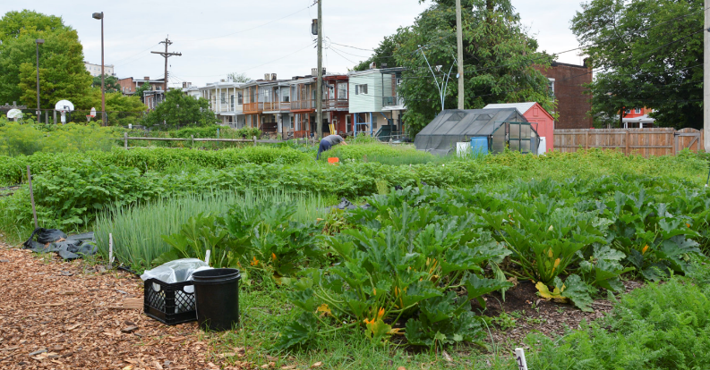
Urban Agriculture in Baltimore City: Context, Resources, & Regulations
Pictured: Whitelock Community Farm

Slide 2
The Office of Sustainability develops and advocates for programs, policies and actions by government, citizens, businesses, and institutions that improve the long-term environmental, social, and economic viability of Baltimore City.
→ www.baltimoresustainability.org ←

Slide 3
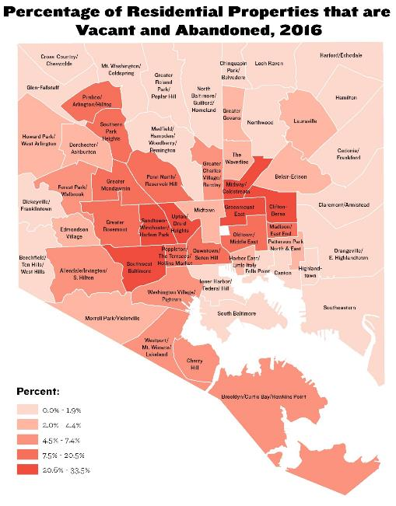
Land Context:
~30,000 vacant properties (14,000 lots + 16,000 structures)
~25% owned by the City
Concentrated in African-American & low-income neighborhoods impacted by racism and disinvestment
Thousands more vacant lots being created
Conversations ongoing around community-led maintenance, greening, and control of land
Notes:
Height of pop in 1940s
Decline steadily since then, arrested for first time in 2012
10,000 families won’t get us close to historical pop height
We WILL be a smaller city for foreseeable future
Need real solutions for vacant land, both short, mid, and long term

Slide 4
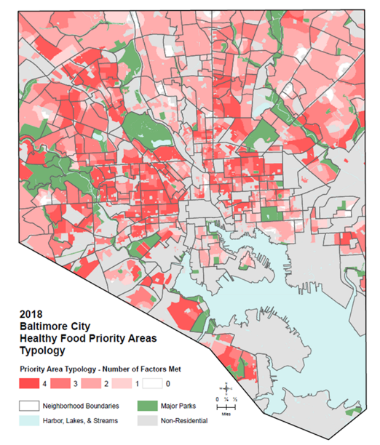
Food Context:
Healthy Food Priority Areas: healthy food availability limited due to distance from grocery stores, what local stores stock, transportation access, and income
~146,000 Baltimore residents live in HFPAs:
23.5% overall pop.
28.3% of children
31.5% of African-American residents
8.9% of white residents
Notes:
Height of pop in 1940s
Decline steadily since then, arrested for first time in 2012
10,000 families won’t get us close to historical pop height
We WILL be a smaller city for foreseeable future
Need real solutions for vacant land, both short, mid, and long term

Slide 5
Agriculture Context:
We have ID’ed 119 food-producing community gardens & urban farms on private & city-owned properties (not including campuses of schools and faith-based institutions)
These sites total ~30 acres across 80 neighborhoods
Many are in/near HFPAs and address food needs
Notes:
Height of pop in 1940s
Decline steadily since then, arrested for first time in 2012
10,000 families won’t get us close to historical pop height
We WILL be a smaller city for foreseeable future
Need real solutions for vacant land, both short, mid, and long term

Slide 6
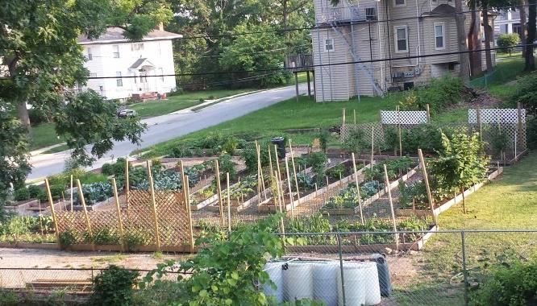
Victorine Q. Adams Community Garden
Notes:
Examples of different types of farms and gardens in Baltimore

Slide 7
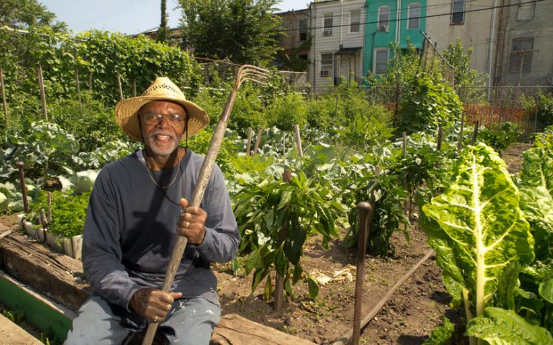
Duncan Street Miracle Garden

Slide 8
Whitelock Community Farm

Slide 9
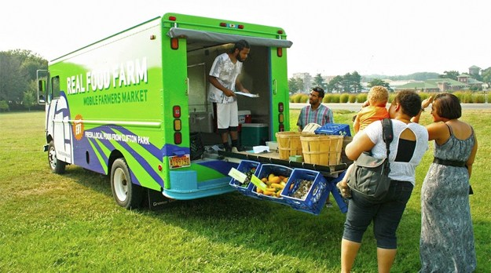
Real Food Farm Mobile Market

Slide 10
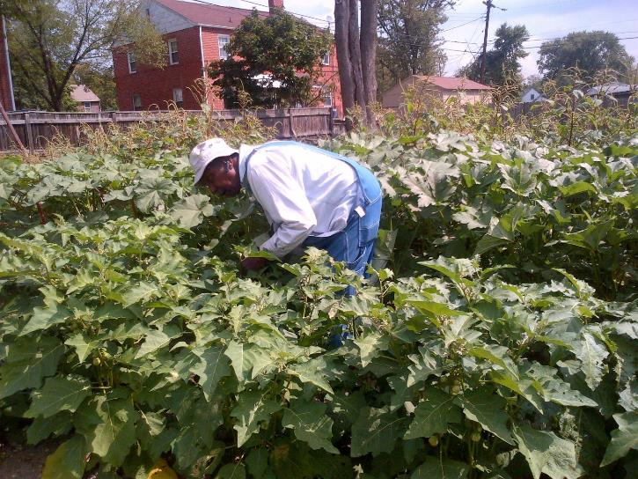
The Greener Garden

Slide 11
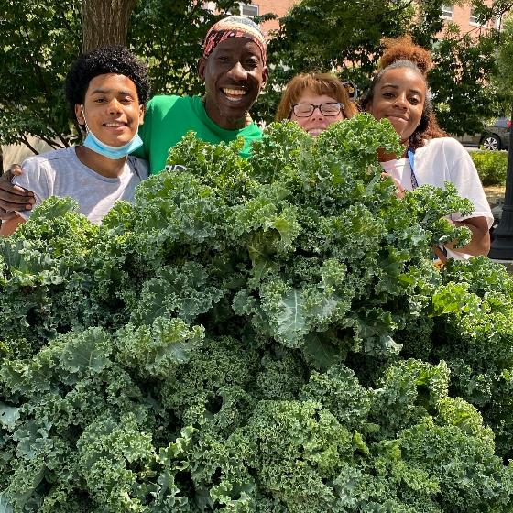
The Plantation Park Heights Urban Garden

Slide 12
Policy Context:
Homegrown Baltimore: Grow Local adopted in 2013
inter-agency & community effort
25 major recommendations
Agriculture included in the Baltimore Green Network Plan (2018) for vacant lot revitalization
2019 Baltimore Sustainability Plan has urban agriculture chapter

Slide 13
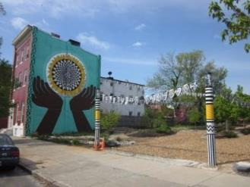
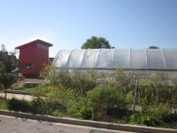
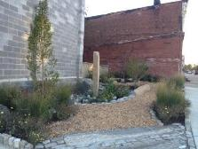
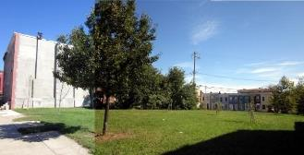
How Do We Grow a Green City?
Promoting eight different green “patterns” for re-using vacant land:
Clean and Green
Community Managed Open Space
Urban Agriculture
Green Parking
Stormwater Management
Urban Forests
Neighborhood Parks
Mixed Greens

Slide 14
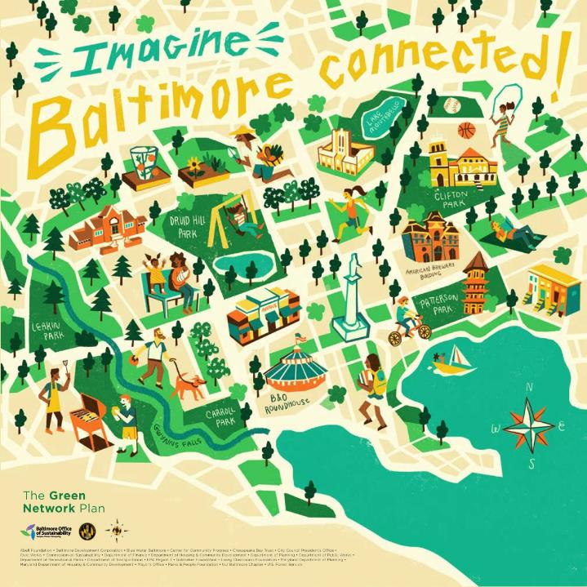

Slide 17
Covid-19 Context
Farms and gardens struggled due to stay-at-home orders and unmet infrastructure needs; city government and local non-profits provided info, emergency funds, and connections to volunteers
Multiple farms are acting as distribution hubs for federal and local food resources
The Farm Alliance of Baltimore received federal funding to start a new farmer training program and entered an agreement with the Baltimore City Department of Recreation & Parks for a Farm Incubator site on park land in south Baltimore

Slide 18
Future Areas for Policy Work
Land Control – the Community Control of Land: The People’s Demand for Land Reparations in Baltimore City (2021) report by the Black Yield Institute and Farm Alliance of Baltimore addresses policies around decision-making, financing, land transfers, water & sewer access, etc.
Indoor growing – our zoning & permitting regulations for urban agriculture were written with outdoor operations in mind. Indoor growing operations can be permitted but are more limited in where they can locate.
Equity – while our new Sustainability Plan addresses the need to support historically disenfranchised communities, we need specific policies and practices in place to do so.
Immigrants and refugees – these populations often have a great deal of agricultural knowledge and skill, but are not adequately reached by existing outreach efforts.
Cannabis – the cannabis growing industry is not currently benefitting Baltimoreans but could be a huge economic boon; we must plan proactively to make this happen.

Slide 19
Resources

Slide 20
Black Yield Institute

Slide 21
Farm Alliance of Baltimore

Slide 22
Beginning Farmer Training Program

Slide 23
Black Church Food Security Network

Slide 24
UME Master Gardeners

Slide 25
Baltimore Green Space

Slide 26
And much more!
Networking and training opportunities
Grants and loans
Sources for supplies
Programs for school gardens
Support for orchards and animal-keeping
Full list: https://www.baltimoresustainability.org/wp-content/uploads/2020/03/Homegrown-Baltimore-Resources-List.docx

Slide 27
Accessing City-Owned Land

Slide 28
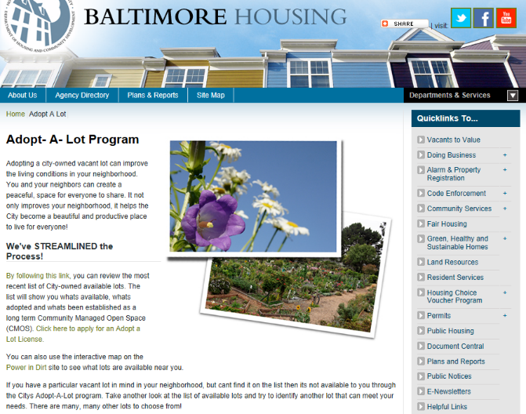
Adopt a Lot Program
https://dhcd.baltimorecity.gov/nd/adopt-lot-program

Slide 29
Adopt a Lot Program
Free
Provides you with a license to legally enter the property and conduct certain activities
Can technically be revoked at any time
Policy is to give one growing season’s notice before canceling the license

Slide 30
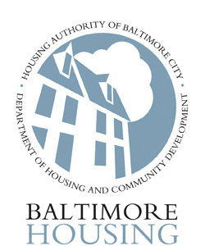
Homegrown Baltimore Land Leasing Initiative
&

Slide 31
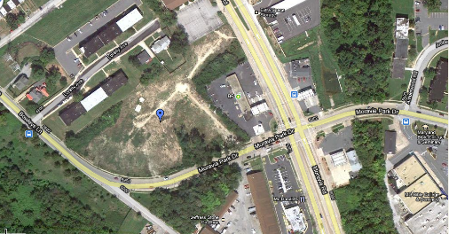
Land Assessment
Conditions sought:
Contiguous
One acre or larger
City-owned
Flat
Open to the sun
No short to mid term development plans
Approximately 35 acres identified – most need a lot of prep and outreach!

Slide 32
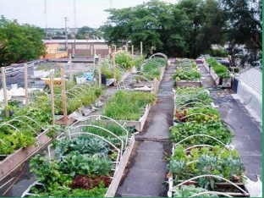
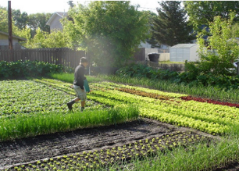
Pre-Qualification Application https://www.baltimoresustainability.org/projects/baltimore-food-policy-initiative/homegrown-baltimore/urban-agriculture-2
Minimum qualifications:
At least 1 year of experience
Sustainable management plan
Openness to community involvement
Financially sound proposal
Terms:
Rolling deadline to apply
5-year leases (with 2-year notice to vacate), terms based on farm type
$100/year
Funding available to help with initial capital costs

Slide 33
Zoning and Permitting

Slide 34
What Changed?
Previously: Most community gardens and urban farms were not technically permitted and were instead allowed as “temporary uses”.
Under new Code: Community gardens (aka Community-Managed Open Spaces) are a permitted use in most districts unless they incorporate certain features in which case they are conditional uses. Urban agriculture (aka farms) is a conditional use in most districts.

Slide 35
Definitions
Community-Managed Open Space. An open space area that is maintained by more than one (1) household and is used either for the cultivation of fruits, flowers, vegetables or ornamental plants; or as a community gathering space for passive or active recreation.

Slide 36
Definitions
Urban Agriculture. The cultivation, processing, and marketing of food, with a primary emphasis on operating as a business enterprise for income generation. Urban agriculture includes animal husbandry, aquaculture, agro-forestry, vineyards and wineries, and horticulture, and might involve the use of intensive production methods, structures for extended growing seasons, on-site sales of produce, and composting.

Slide 37
Where are they allowed?
Community-Managed Open Spaces are a permitted use in all zoning districts (unless they incorporate certain features) and Urban Agriculture will be a conditional use in all zoning districts with the exception of industrial zones, which are as follows:
OIC = Office-Industrial Campus BSC = Bio-Science Campus
I-MU = Industrial Mixed-Use I-1 = Light Industrial
I-2 = General Industrial MI = Maritime Industrial
 | OIC | BSC | I-MU | I-1 | I-2 | MI
CMOS | P | P | P
UA | P | P | P | P

Slide 38
What would make a garden conditional?
Community-Managed Open Space uses are conditional if they incorporate:
On-site composting
On-site sales, or
The keeping of animals.

Slide 39
Permitted Uses
A use permit is required before any person may use, for any purpose, previously-vacant land, or make any changes in the authorized use of any land or structure.
As long as use standards are met, permitted uses are allowed by default. An inspector will review your application and check in with other city agencies.

Slide 40
Permitted Uses
One-time filing/permit fee of $50-$100, depending on the complexity of your plans.
You must own the site or have permission from the owner, otherwise sites will continue to be considered “temporary uses”.

Slide 41
Conditional Uses
A use is conditional when the impact on the public must be considered on a case by case basis.
The Baltimore City Municipal Zoning and Appeals Board conducts a public hearing w/in 75 days of application. A notice of the hearing must be posted on the property by the applicant.

Slide 42
Conditional Uses
Conditional requests must be approved unless contrary to public interest, detrimental to public welfare, precluded by another law or Urban Renewal Plan, or not in harmony w/ the intent of the Code.
Considerations include traffic, future development, surrounding uses, accessibility, and preservation.

Slide 43
Conditional Uses
There is a one-time filing fee of $250. Up to $100 of additional fees may apply, depending on the complexity of your plans.
Conditions may be placed on a conditional use permit, such as on hours of operation, setbacks, and types of activities.

Slide 44
Use Standards: CMOS
(1) Limited to the cultivation of herbs, fruits, flowers, or vegetables, and may also include community gathering spaces for active or passive recreation, not including playgrounds.
(2) Keeping of livestock permitted as per Health Department regulations.
(3) For any cultivation of plants for human consumption, the applicant must use imported, clean soil OR soil testing is required and proposed remediation methodology, if needed, must be presented.
(4) Permanent structures are prohibited, but temporary greenhouses, sheds, gazebos, and pergolas, are permitted.
(5) One farmstand per zoning lot is permitted and is limited to sales of items grown at the site, must be stored when the site is not open for public use.

Slide 45
Use Standards: Urban Ag
(1) Urban ag uses that involving the following must submit a management plan for approval:
Animal husbandry
Processing of food produced on site.
Spreading of manure, sludge, or other nutrient-rich fertilizers.
Spraying of agricultural chemicals, including fertilizers, fungicides and pesticides.
Use of heavy equipment such as tractors.
(2) Greenhouses are permitted, either permanent or temporary.
(3) For any cultivation of plants for human consumption, the applicant must use imported, clean soil OR soil testing is required and proposed remediation methodology, if needed, must be presented.

Slide 46
Use Standards: Urban Ag (cont.)
(4) Permanent accessory structures limited to tool sheds, shade pavilions, barns, rest-room facilities, planting prep houses, and post-harvest processing facilities. Buildings must be set back 10 feet from lot lines and must be under 25 feet in height, except for structures designed to capture wind energy which may be taller.
(5) Combined area of all accessory structures limited to 25% of total lot area.
(6) Farmstands permitted, must be stored when the site is not open for public use.

Slide 47
Animal Husbandry

Slide 48
Updated in 2013
The Baltimore City Health Department regulates what animals may be kept in the city and the conditions required.
The “Regulations for Wild, Exotic, and Hybrid Animals” were updated in September 2013.
Full text here: https://www.baltimoresustainability.org/projects/baltimore-food-policy-initiative/homegrown-baltimore/urban-agriculture-2

Slide 49
Honey Bees
Register with the MD Dept. of Agriculture.
No more than 2 colonies and 1 nucleus colony on lots up to 2,500 square feet.
1 additional colony and 1 additional nucleus colony permitted for every additional 2,500 sf.
Inaccessible to the general public
At least 5’ from any lot line except where a solid wall/fence of at least 5’ high is a barrier)
Kept in such a way that they do not unreasonably interfere with surrounding uses and public right of ways.

Slide 50
Chickens
Register with the MD Dept. of Agriculture.
No more than 4 chickens over 1 month of age on lots smaller than 2,000 square feet.
1 additional chicken may be kept for every 1,000 sf up to a maximum total of 10.
Community gardens and urban farms may apply to keep more chickens, up to a total of 50. Must have a management plan.

Slide 51
Chickens
No roosters.
Sanitary and adequately sized coop or loft which must be clean, moved regularly, allows 2 sf per hen, provides shelter and shade, and is at least 15 feet from any residence.
Must be provided with fresh food and water and cared for if sick or injured.

Slide 52
Rabbits
On lots under 1,000 square feet, no more than 1 breeding pair and 12 rabbits total.
On lots over 1,000 sf, no more than 2 breeding pairs and 24 rabbits total.
Sanitary and adequately-sized enclosure or pen which must be clean, moved regularly, allows 3 sf per rabbit, provides shelter and shade, is at least 15 feet from any residence.
Must be provided with fresh food and water and cared for if sick or injured.

Slide 53
Goats
Must be miniature, dwarf, or pygmy breeds.
2 goats plus any offspring under 6 months of age on lots smaller than 20,000 square feet.
1 additional goat for every 5,000 sf after that up to a max. of 6.
Must be dehorned and, for male goats over the age of 6 months, neutered.
At least 150 square feet of permeable space each in fenced, graded, drained, and clean yard.
Must be provided with fresh food and water.

Slide 54
Special Rules
Must submit a permit application within 10 days of acquiring the animal(s).
Applicant and any employees can’t have been convicted of animal abuse, cruelty, or neglect
Must provide a photo and proof of any relevant vaccinations and health examinations (bees exempt).

Slide 55
Special Rules
Must have permission from property owner(s).
There is a one-time fee of $80 per animal type per address (bees exempt).
Permit is only valid for the location where the animals are normally housed (bees exempt).
Slaughter is prohibited.

Slide 56
What about fish?
Many other livestock animals, such as sheep, cows, etc. are specifically prohibited by the Health Code, but fish are not mentioned, meaning they may be kept without a city permit.
The Maryland Department of Natural Resources DOES regulate aquaculture for potential impacts on surrounding water bodies. There is a permit required, which is free.
Visit http://dnr.maryland.gov/fisheries/pages/aquaculture/nonshellfish.aspx to learn more.

Slide 57
Soils Issues

Slide 58
City Grading Permits
All disturbances of 5,000 square feet or more in Baltimore are required to receive a grading permit before work begins.
Grading permits require approval from the Department of Public Works, who typically review projects for compliance with stormwater management and erosion & sediment control policies.

Slide 59
City Grading Permits
Agriculture is exempt from normal state Stormwater Management and Erosion & Sediment Control requirements UNDER CERTAIN CIRCUMSTANCES AND WITH OTHER PLANS SUBMITTED IN THEIR PLACE.
Structures are generally not exempt.
There will likely be special requirements if you are putting hoop houses on land that was formerly pervious (i.e. open soil/grass).

Slide 60
City Grading Permits
For guidance on your requirements, contact Nathaniel Krause at Nathaniel.Krause@baltimorecity.gov or 410-396-0732
For a grading permit: http://permits.baltimorecity.gov/ or call 410-396-3360 or visit the Permits One-Stop Shop on the first floor of the Charles L. Benton Building at 417 E. Fayette Street, 21202.

Slide 61
Soil Safety Management
The Johns Hopkins Center for a Livable Future tested soil and produce at 100+ gardens & farms in Baltimore City and found that 96% were NOT of concern for lead or other heavy metals. Learn more: https://clf.jhsph.edu/projects/urban-agriculture/safe-urban-harvests-study
HOWEVER – soil testing is not optional! Just because contamination is relatively rare, doesn’t mean it couldn’t harm you.

Slide 62
Soil Safety Management
Under the new Zoning Code, Community-Managed Open Spaces and Urban Agriculture sites using existing soils will be required to submit a Soil Safety Plan.
This short document must include:
Site history
Information on what testing was done
Information on any mitigation to be done
Read the guidance document at https://www.baltimoresustainability.org/projects/baltimore-food-policy-initiative/homegrown-baltimore/urban-agriculture-2

Slide 63
State Nutrient Management Plans
Farms that gross over $2,500 per year are required by the State to create Nutrient Management Programs.
The Farm Alliance of Baltimore City, Real Food Farm, and the University of Maryland Extension may be able to provide info.
Learn more here: http://mda.maryland.gov/resource_conservation/Pages/farmer_information.aspx

Slide 64
Other policies

Slide 65
Other Policies
No building permits required for hoop houses.
Building permits are required for most other types of structures.
Water access available for $120/year: https://dhcd.baltimorecity.gov/nd/adopt-lot-program

Slide 66
Taxes
Per State law, land used for agriculture is assessed at $500 per acre, resulting in a very low tax burden.
However, to qualify, sites must be at least three acres in size, which most city sites are not.

Slide 67
Taxes
Baltimore City has a 90% tax credit for urban agriculture.
Sites receiving the credit can’t be used for any other purpose that would normally be subject to property tax, such as housing.
Sites must remain a farm for five years or else pay back taxes.
Details: http://www.baltimoresustainability.org/projects/baltimore-food-policy-initiative/homegrown-baltimore/urban-agriculture-2/

Slide 68
Stay in touch!
Contact: 410-396-1670 or abby.cocke@baltimorecity.gov
Website: www.baltimoresustainability.org
Commission on Sustainability Meetings: 3rd Wed of every month, 4-6pm, open to the public at https://livestream.com/accounts/17371294
Facebook: www.facebook.com/baltimoresustainability
Twitter & Instagram: @SustainBmore
Monthly Newsletter: Sign up on our website or email us at sustainability@baltimorecity.gov

