Slide 1
Early Economic Impacts of COVID-19
Baltimore City Sustainability Commission
August 19, 2020

Slide 2
TRANSPORTATION IMPACTS

Slide 3
MDOT Weekly Traffic Counts 2019 v. 2020

Slide 4
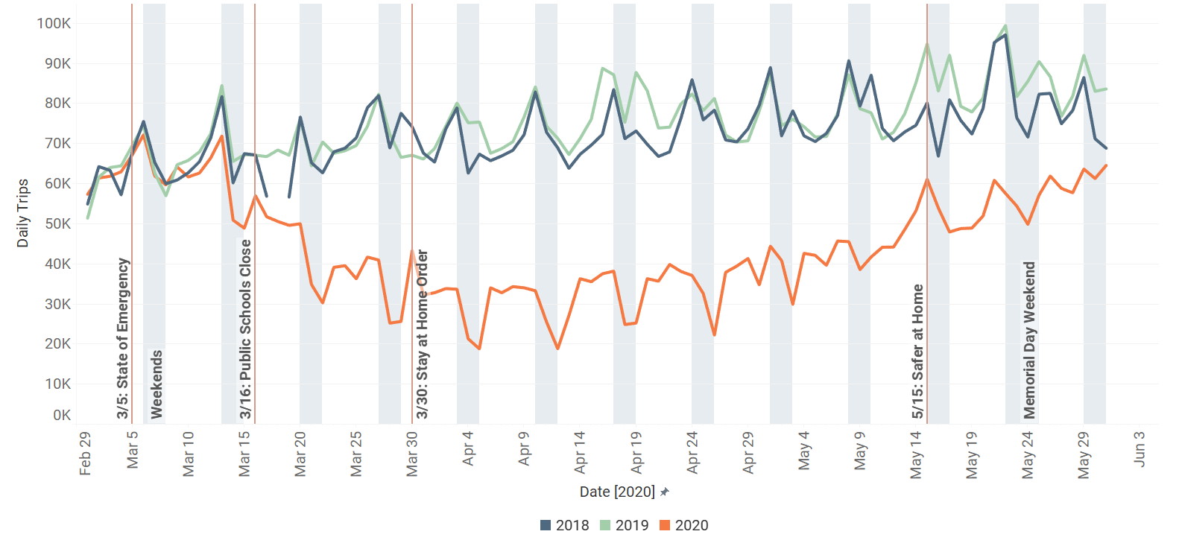
Total Bay Bridge Crossings - 2018/2019/2020

Slide 5
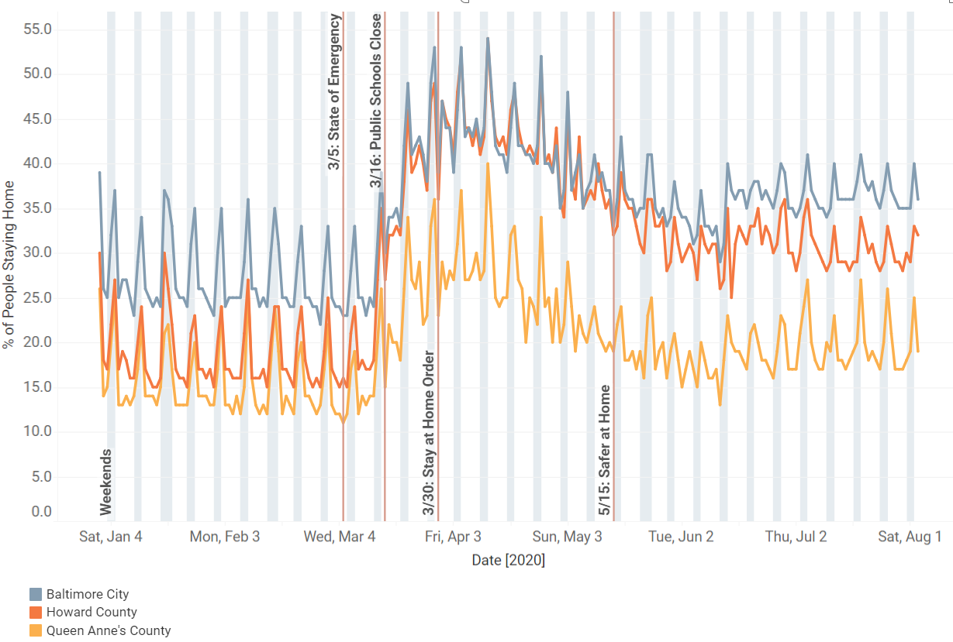
% Staying At Home – By County January - July

Slide 6
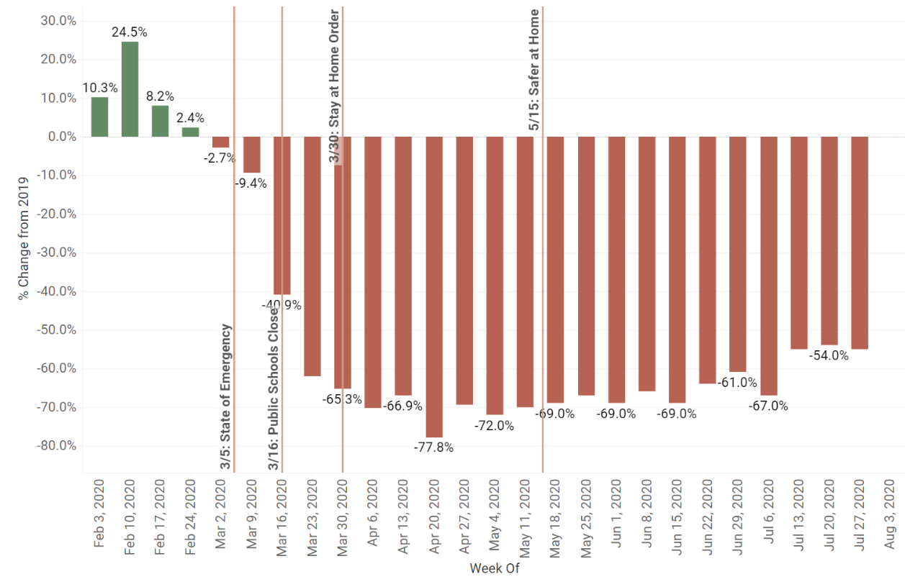
MTA Weekly Ridership –2019 v. 2020

Slide 7
Unemployment Data

Slide 8
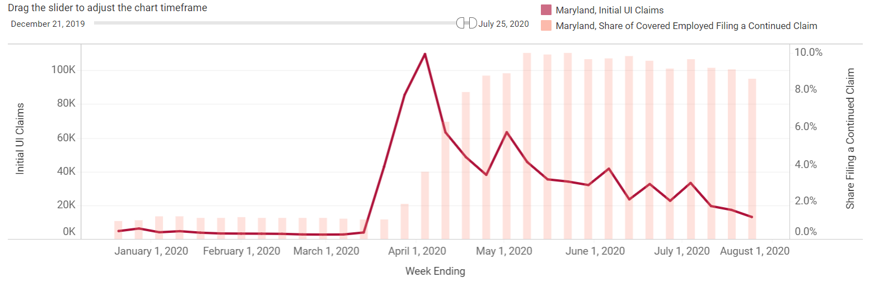
Maryland Initial and Continuing UI Claims

Slide 9
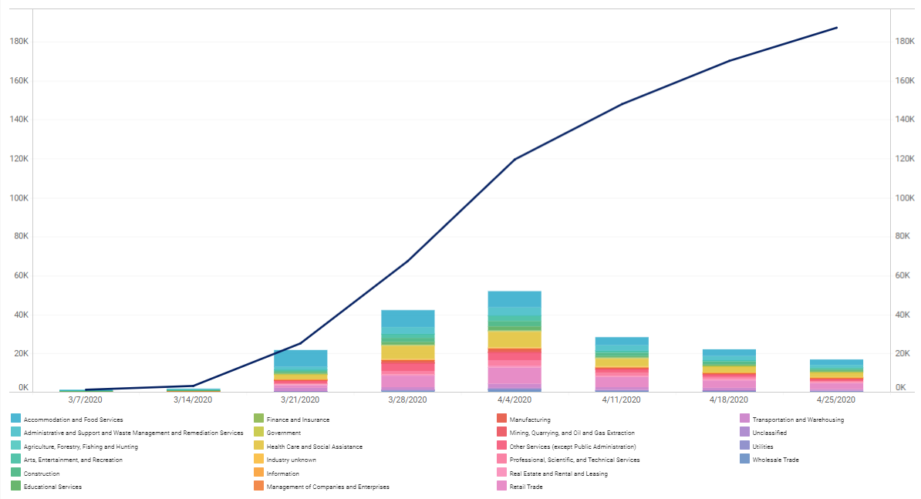
UI CLAIMS THROUGH APRIL: ALL INDUSTRIES

Slide 10
UI CLAIMS THROUGH APRIL: ALL INDUSTRIES
183,000 New Claims

Slide 11
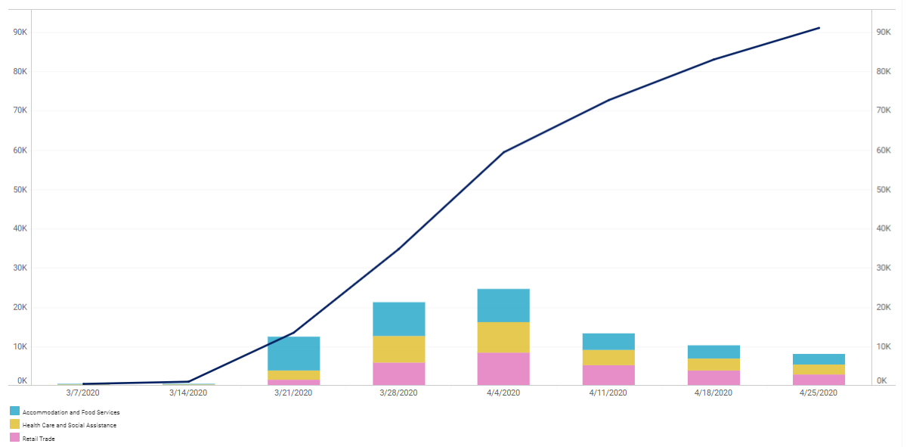
UI CLAIMS THROUGH APRIL: TOP 3 INDUSTRIES

Slide 12
UI CLAIMS THROUGH APRIL: TOP 3 INDUSTRIES
1/2 OF ALL UI CLAIMS

Slide 13
Most Exposed Employment Sectors

Slide 14
Most Exposed Employment Sectors
BLS list of industries directly affected by the shutdown orders
244,921 jobs
18.3% of total jobs in the region
Six General Categories
  Restaurants and Bars
  Other Sensitive Retail
  Travel and Transportation
  Entertainment
  Personal Services
  Sensitive Manufacturing

Slide 15
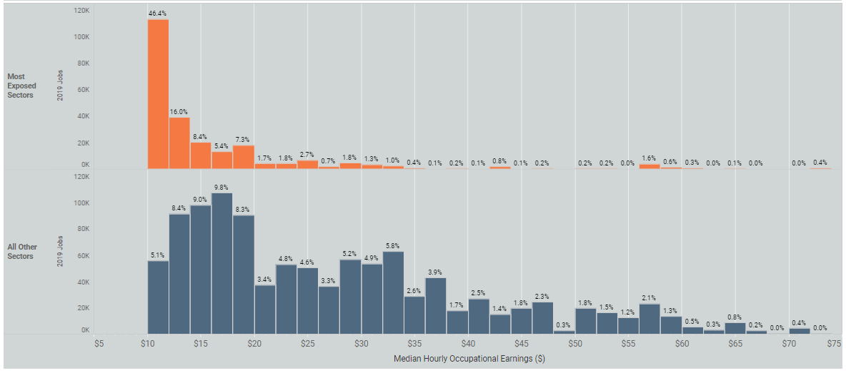
Wage Distribution in Exposed/Other Sectors

Slide 16
Baltimore City: Wage Share by Sector Type
Most Exposed Jobs = 12% of City Jobs
All Other Sectors = 88% of City Jobs

Slide 17
Baltimore City: Wage Share by Race
Black Employees = 36% of City Workforce
White Employees = 50.4% of City Workforce

Slide 18
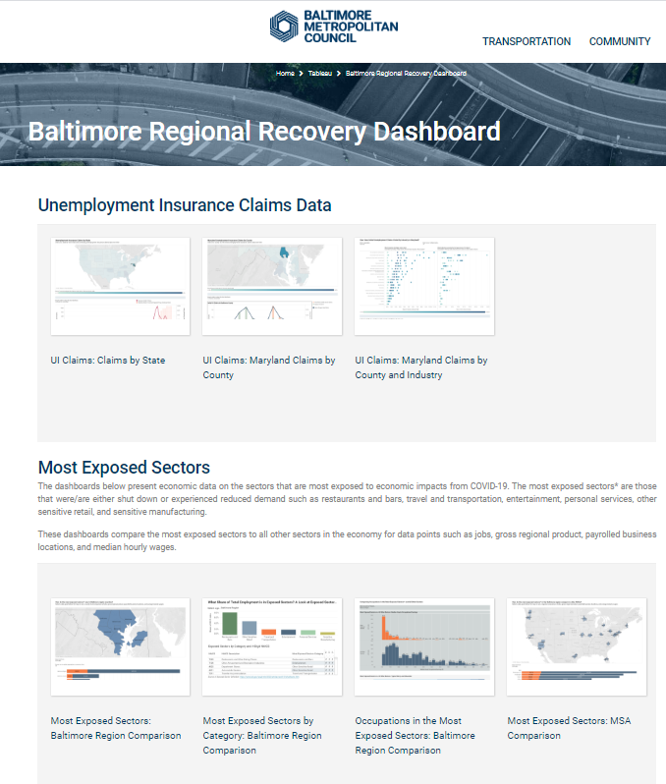
Regional Recovery Dashboard
Transportation, Labor Market, Unemployment Data
We need feedback and suggestions
1-2 year evolving project
https://baltometro.org/data/baltimore-regional-recovery-dashboard

Slide 19
For More Information
Mike Kelly| Executive Director
410-732-0500 | mkelly@baltometro.org | www.baltometro.org

