Slide 1
PROJECT UPDATE
Gathering Input on the Draft Plan
Baltimore Commission on Sustainability
June 17, 2020

Slide 2
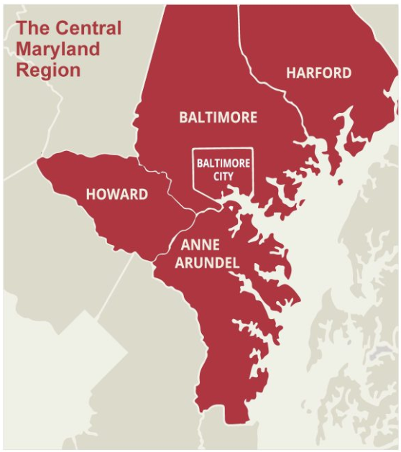
RTP Background | Purpose & Approach
BACKGROUND:
MDOT MTA is developing a 25-year plan to meet Central Maryland’s transit needs
The Plan looks at traditional transit (buses and trains) and explores new mobility options and technology
The Plan includes MDOT, Locally Operated Transit Services (LOTS), and paratransit providers

Slide 3
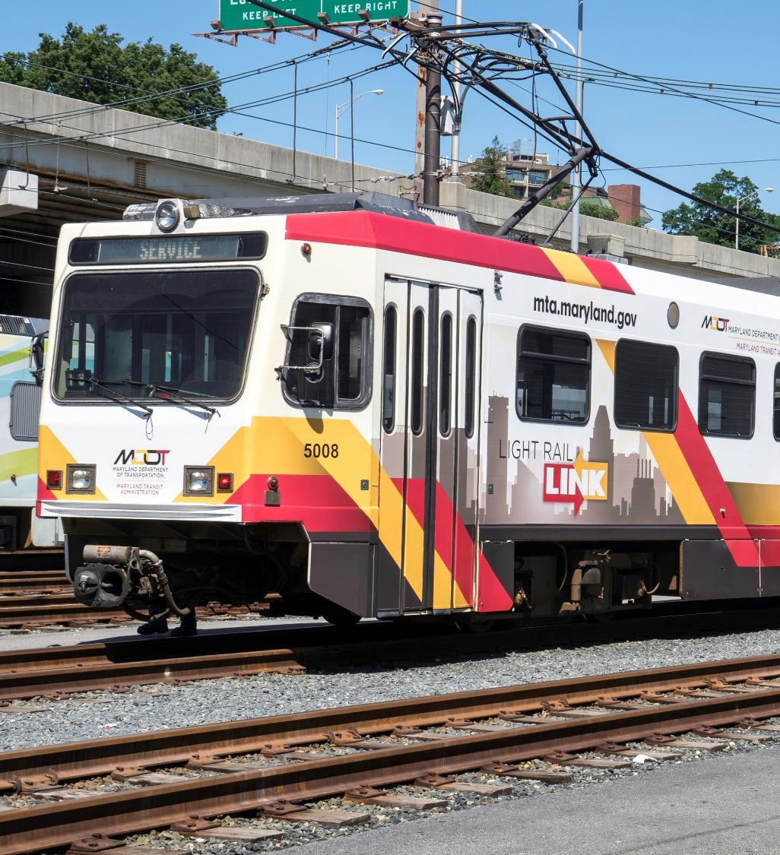
DRAFT PLAN OVERVIEW

Slide 4
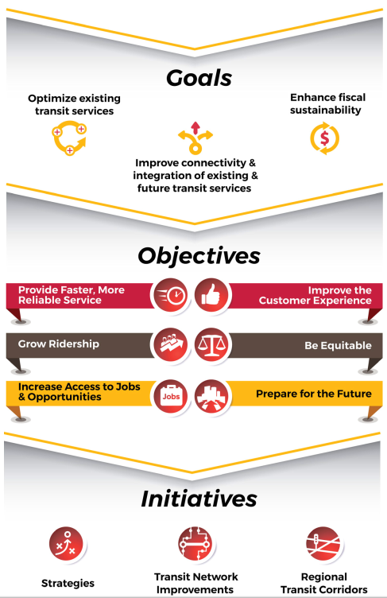
Regional Transit Plan Structure

Slide 5
Draft Plan Overview | Strategies to Support Sustainability
Objective: Prepare for the Future
Strategies:
  Transition to 95% zero-emission vehicles by 2045
  Ensure that facilities have been adapted for zero-emissions readiness
  Install Electric Vehicle (EV) charging devices at parking lots along the Metro Subway, Light Rail, MARC, and Commuter Bus system
“Prepare for the future by mitigating and adapting to climate
change, enhancing the financial stability of transit services, and
embracing emerging technologies.”
Draft RTP - Page 37

Slide 6
Draft Plan Overview | Strategies to Support Sustainability
Objective: Grow Ridership
Strategies:
  Partner with employers and large-scale development to connect residents to job centers
  Pursue transit-oriented development (TOD) at Light Rail, Metro Subway, and MARC Train stations
  Expand Light Rail service hours and frequency, including Sunday service
“Transit is an essential tool in environmental sustainability.”
Draft RTP - Page 37

Slide 7
Draft Plan Overview | Strategies to Support Sustainability
Objective: Be Equitable
Strategies:
  Explore options and implement measures to facilitate fare payment for riders without access to a credit or debit card.
  Actively pursue partnerships with non-profit, philanthropic, and workforce development organizations to ensure access to transit for their constituents.
For minority and low-income communities in Central Maryland, safe and affordable mobility options are essential for overcoming long-standing disparities in the distribution of resources and opportunities.

Slide 8
Draft Plan Overview | Strategies to Support Sustainability
Objective: Be Equitable
Strategies:
  Ensure that transit projects seek to reduce, rather than expand, current or historic disparities in terms of access to opportunities for low-income and minority communities.
  Create an Equity Manager position to review completed projects, and to proactively integrate an equity perspective into transit planning, service provision, and communication.
  Review transit service plans through an equity lens, considering race, income, age, disability, English language proficiency, and vehicle access.
A one-size-fits-all process will not produce fair results for all communities, particularly minority and low-income communities because each have distinct needs and challenges.

Slide 9
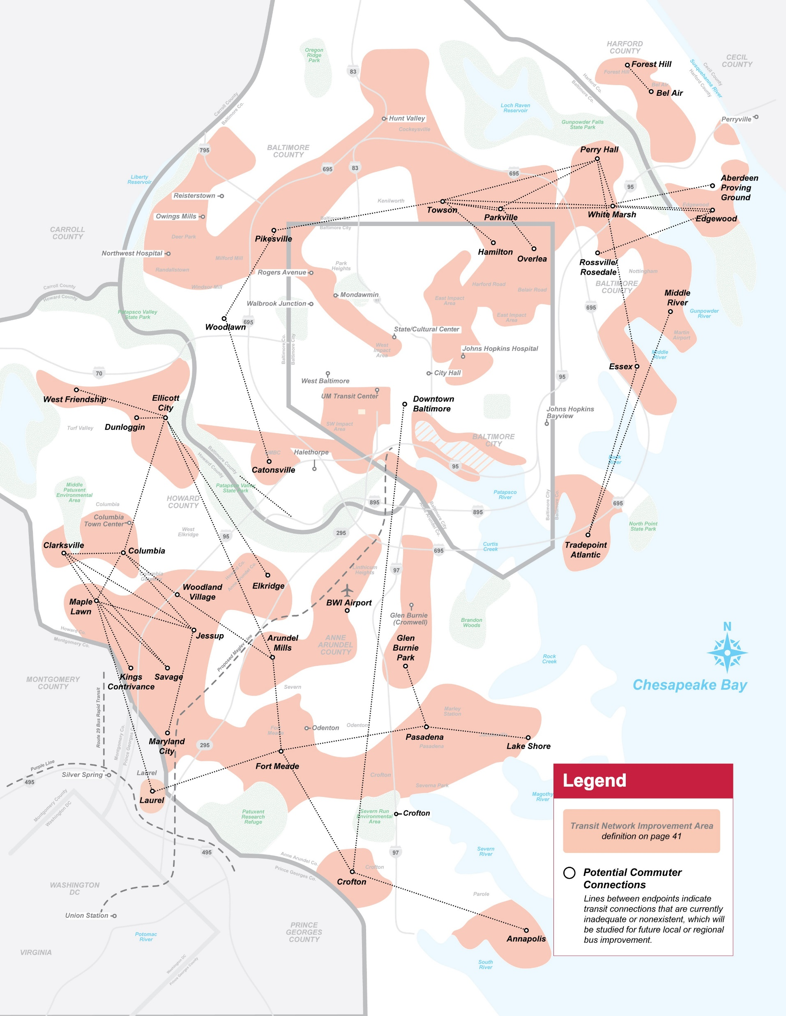
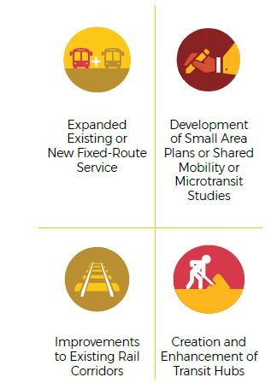
Draft Plan Overview | Transit Network Improvements
TRANSIT NETWORK IMPROVEMENTS expand or enhance current or previous investments.

Slide 10
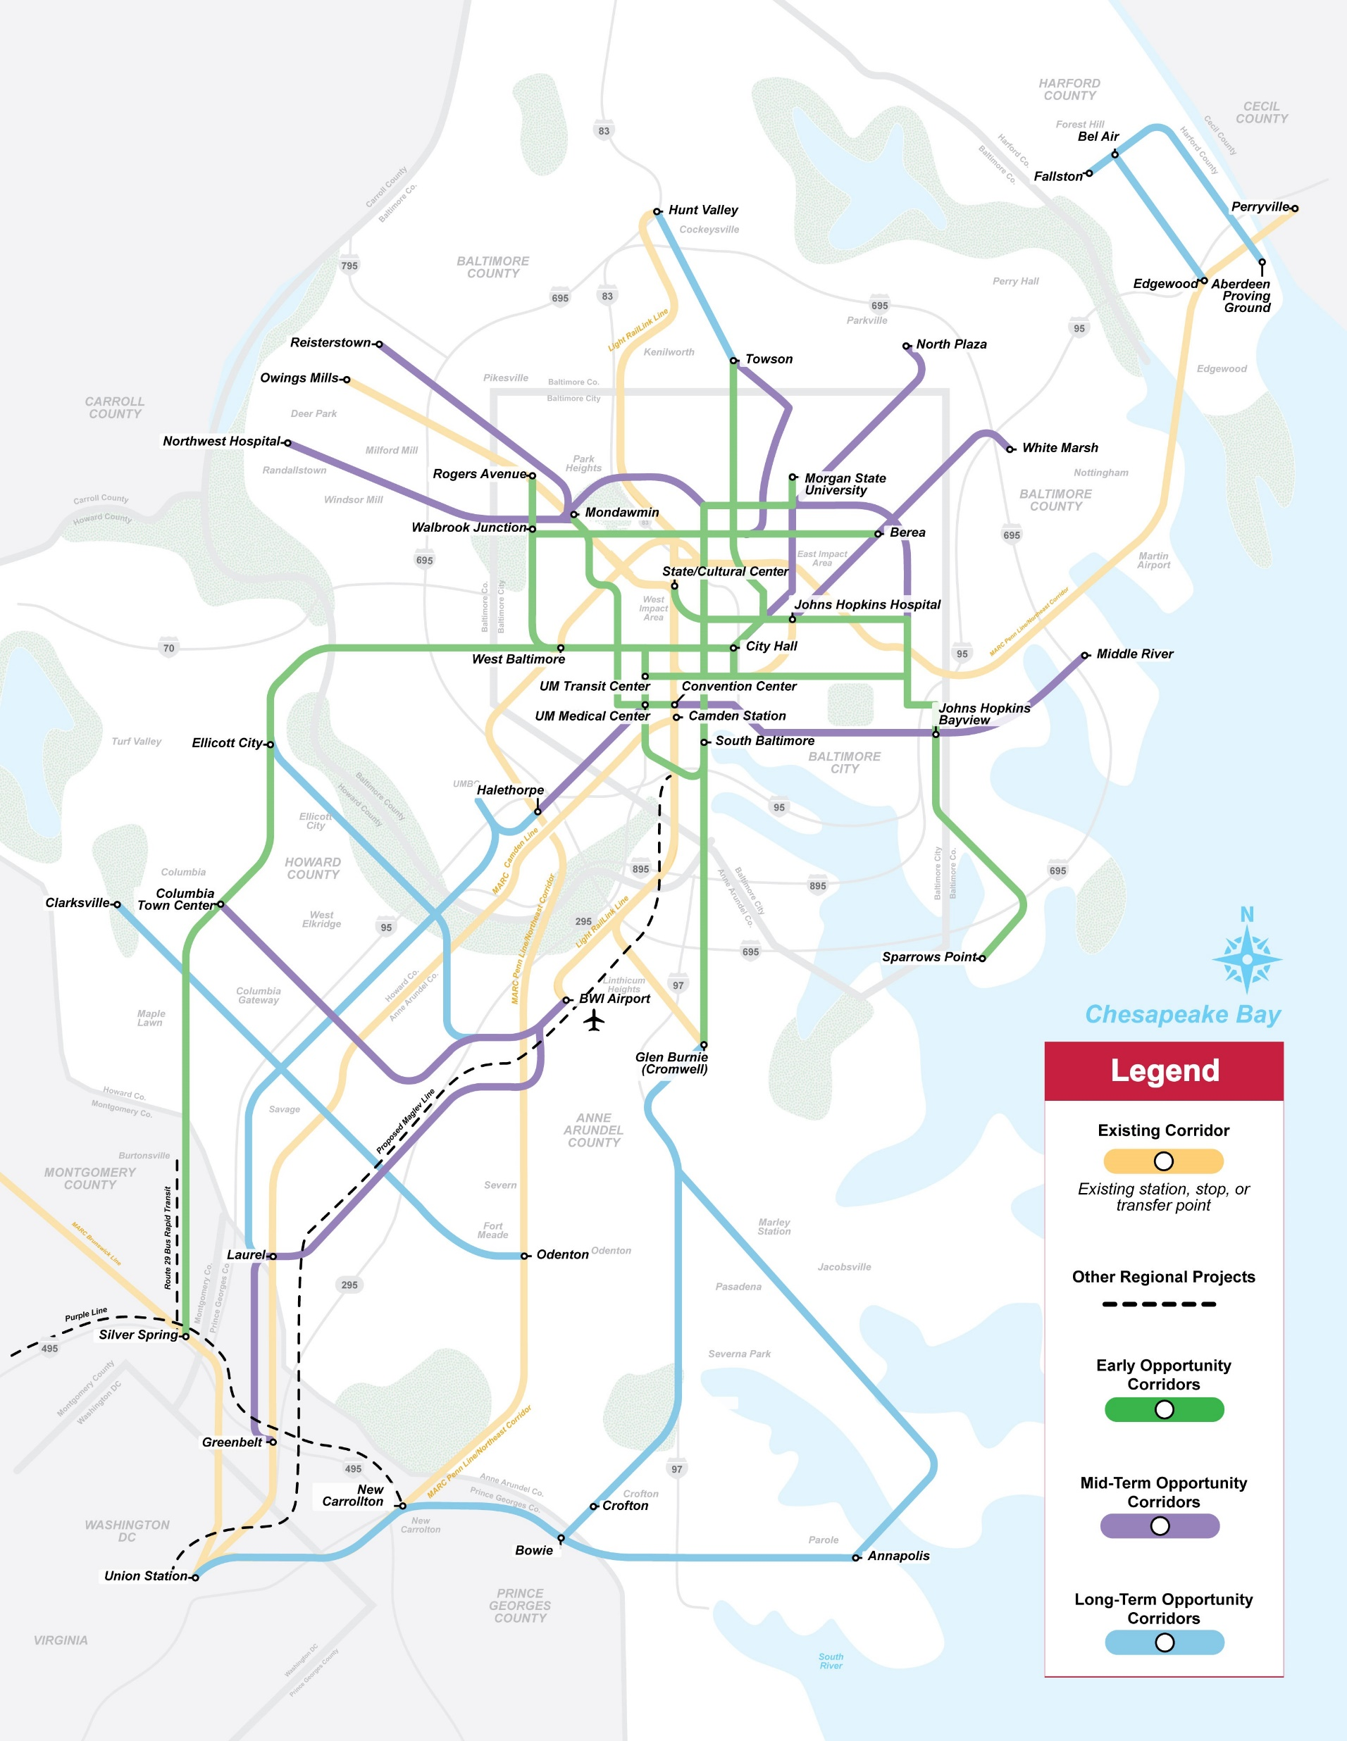
Draft Plan Overview | Regional Transit Corridors
REGIONAL TRANSIT CORRIDORS demonstrate:
Transit demand that justifies infrastructure, service, and/or technology improvements.
Demand supporting all-day frequent service.
Regional significance, often providing connectivity between different jurisdictions.

Slide 11
Draft Plan Overview | Targets
The Plan identifies baselines and 2025 and 2045 targets, which will be tracked on a Progress Dashboard. Examples are:
Target | Baseline | 2025 | 2045
Percent of the region’s jobs within ¼-mile of a bus stop or ½-mile of a rail station | 50% | 55% | 70%
Percentage of fleet that are zero-emissions vehicles (ZEV) | 0% | Initiate ZEV procurement | 95%
Percentage of people traveling by transit in the region | 6% | 9% | 15%
Percent areas of persistent poverty with access to transit | 64% | 70% | 80%
Percent of no-car households with access to frequent transit | 52% | 55% | 72%
Percent of assets (by value) in State of Good Repair backlog | 16% | 10% | 5%
Notes:
Bold notes that these are new of different from the draft by proposed changes in response to input from the public and Commission members

Slide 12
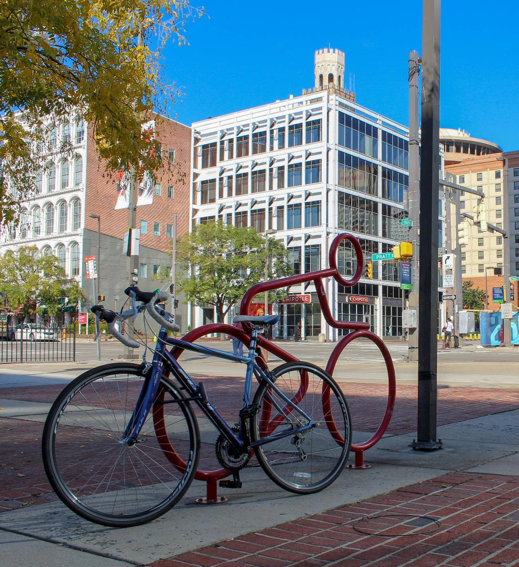
REVIEW PROCESS & NEXT STEPS

Slide 13
Outreach & Review Process
Primarily virtual outreach due to COVID-19:
Interactive web tool facilitates easy review and comment
Targeted outreach with geo-targeted social media ads and presentations to key groups (like this one!)
Newspaper ads and transit vehicle “car card” displays to notify regional residents
Screen-reader accessible and Spanish-language documents
Project hotline to call for additional information
Live Chat with Project Team to ask questions about the draft Plan
Notes:
Suggest noting that we’ve also proactively distributed some hard copy plans and made phone calls to some constituents to make sure we don’t miss people due to online focus

Slide 14
Next Steps and Key Dates
The Draft Plan launched April 22nd and will be open for public comment through June 18th
Virtual Commission meeting June 18th to discuss comments/public input:
  By computer: rtp.mta.maryland.gov/commission
  Call-in: 408-418-9388
  Enter Access Code: 713 207 356
The Plan must be finalized prior to October 1st

Slide 15
Questions
Thank you!

