Slide 1
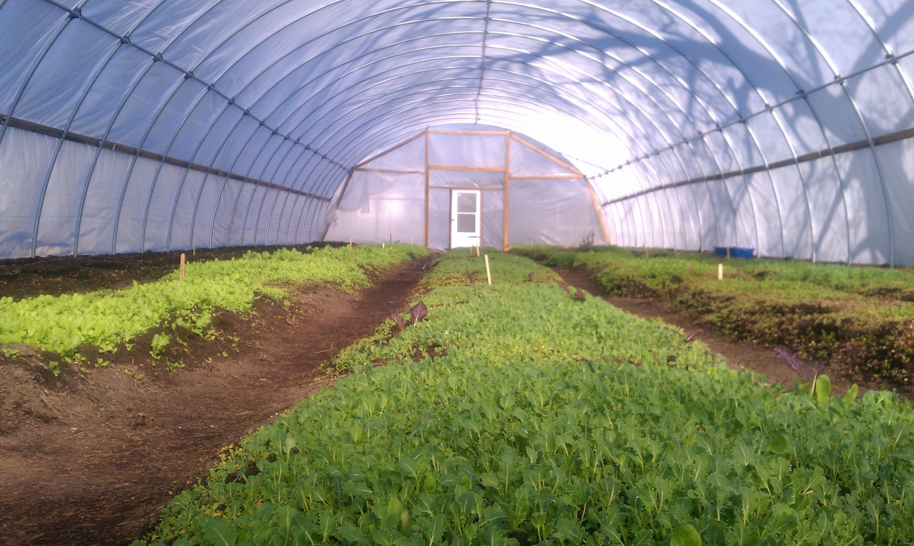
Urban Agriculture in Baltimore City Presented by Abby Cocke, Environmental Planner, Baltimore Office of Sustainability

Slide 2
Context

Slide 3
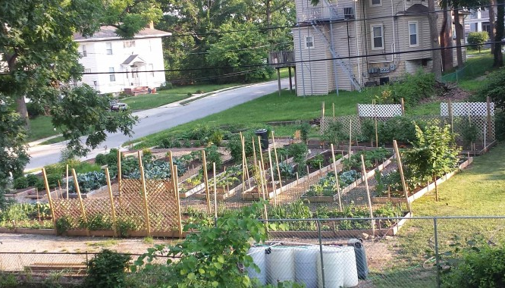
Victorine Q. Adams Community Garden

Slide 4
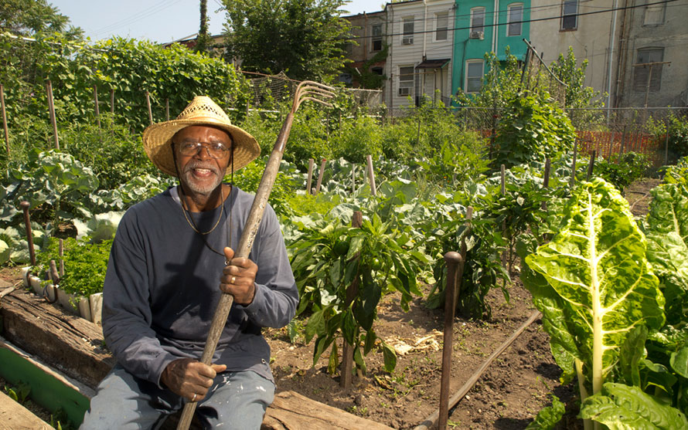
Duncan Street Miracle Garden

Slide 6
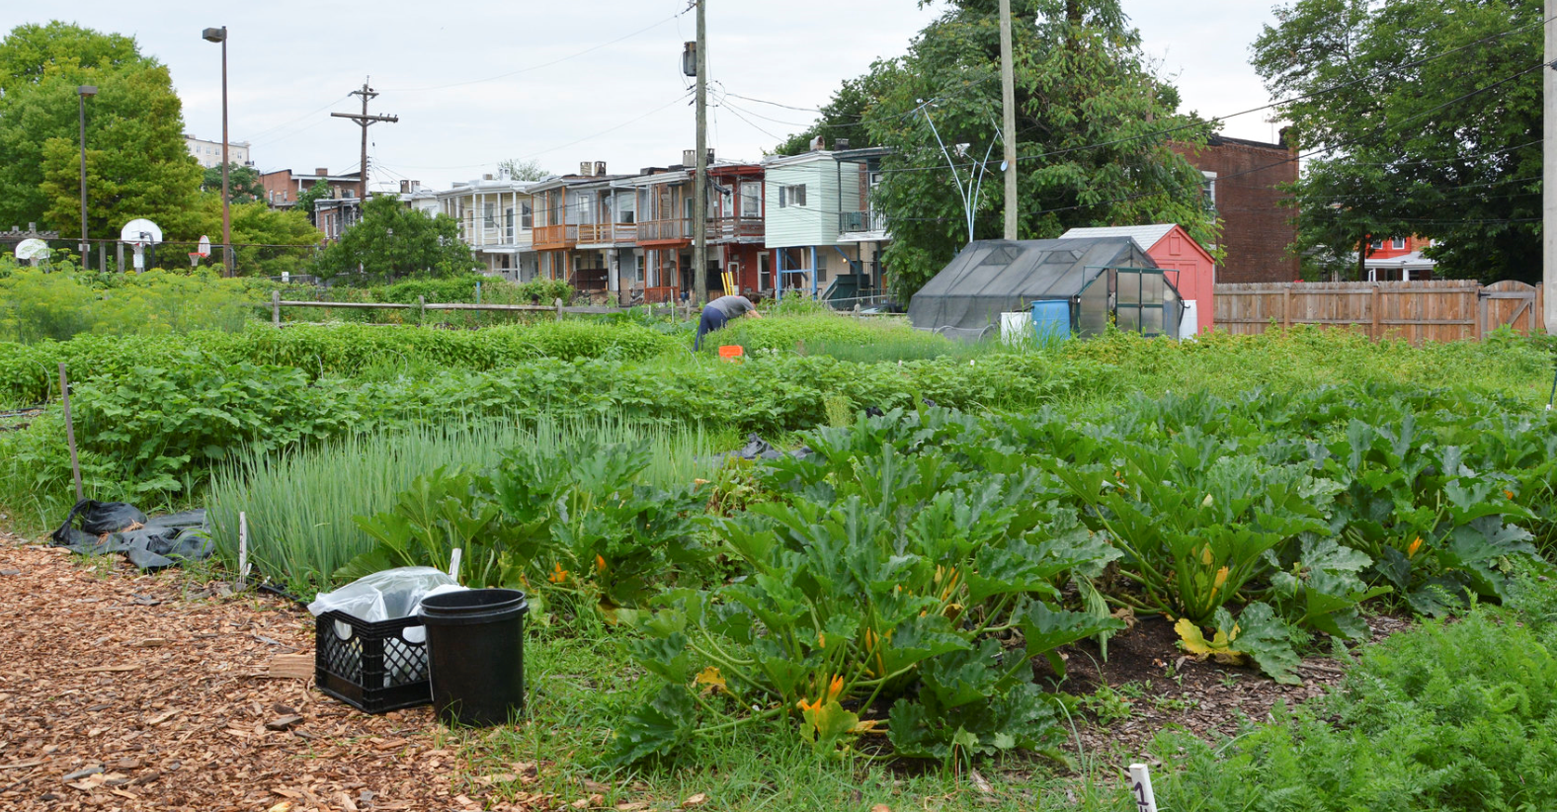
Farm Alliance of Baltimore
Visit: http://www.farmalliancebaltimore.org/

Slide 7
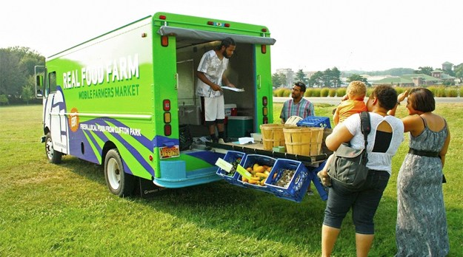
Farm Alliance of Baltimore
Visit: http://www.farmalliancebaltimore.org/

Slide 8
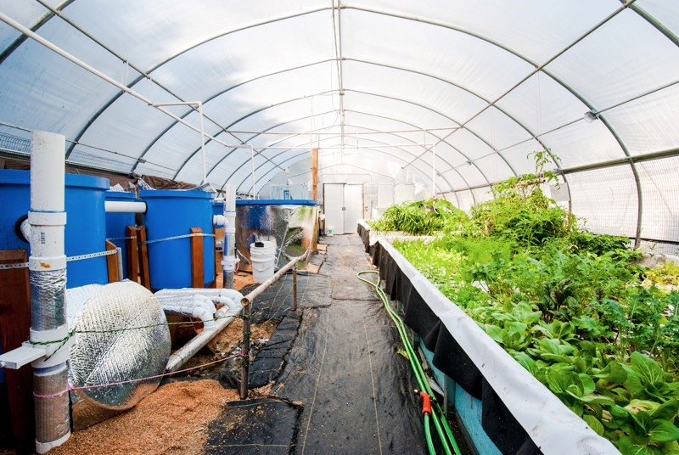
Farm Alliance of Baltimore
Visit: http://www.farmalliancebaltimore.org/

Slide 9
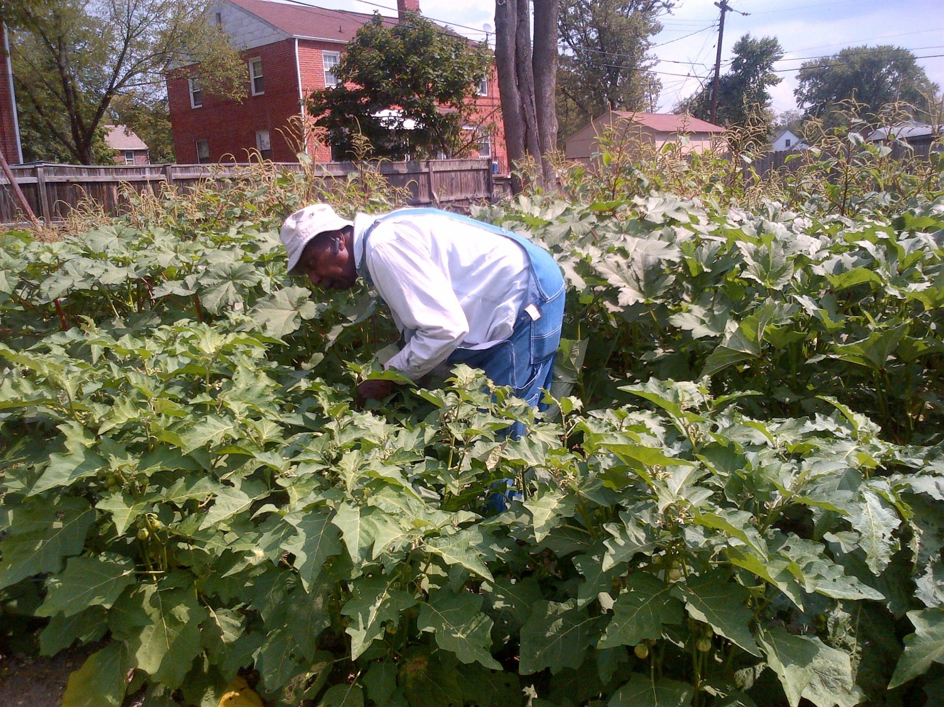
Farm Alliance of Baltimore
Visit: http://www.farmalliancebaltimore.org/

Slide 10
The Office of Sustainability develops and advocates for programs, policies and actions by government, citizens, businesses, and institutions that improve the long-term environmental, social, and economic viability of Baltimore City.

Slide 11
The Office of Sustainability develops and advocates for programs, policies and actions by government, citizens, businesses, and institutions that improve the long-term environmental, social, and economic viability of Baltimore City.
→ www.baltimoresustainability.org ←

Slide 12
- Context
- Land Assessment
- Policy Context
- Current Activities
- 25 Major Recommendations: Land, Water, Soil, Capital, Support
- Buy Local, Eat Local
- Appendices of relevant city code
www.baltimoresustainability.org/homegrown-baltimore-grow-local

Slide 13
The Green Pattern Book is a tool to support the greening of vacant land by City agencies, NGOs, community-based organizations, and individual residents by creating a ‘common language’.
This document includes information on:
Visioning
Site selection
Guidelines
Resources

Slide 14
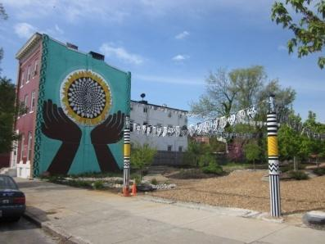
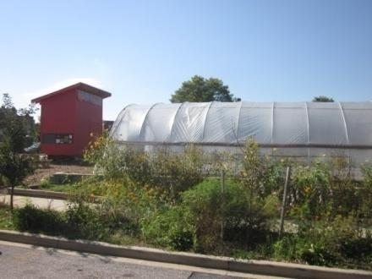
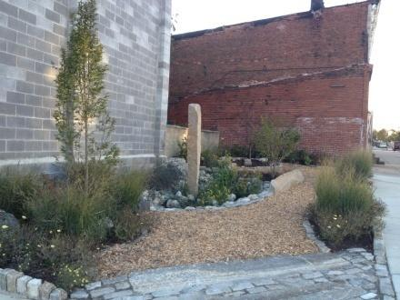
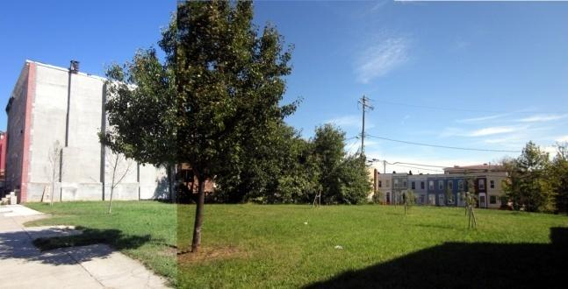
How Do We Grow a Green City?
Promoting eight different green “patterns” for re-using vacant land:
Clean and Green
Community Managed Open Space
Urban Agriculture
Green Parking
Stormwater Management
Urban Forests
Neighborhood Parks
Mixed Greens

Slide 15
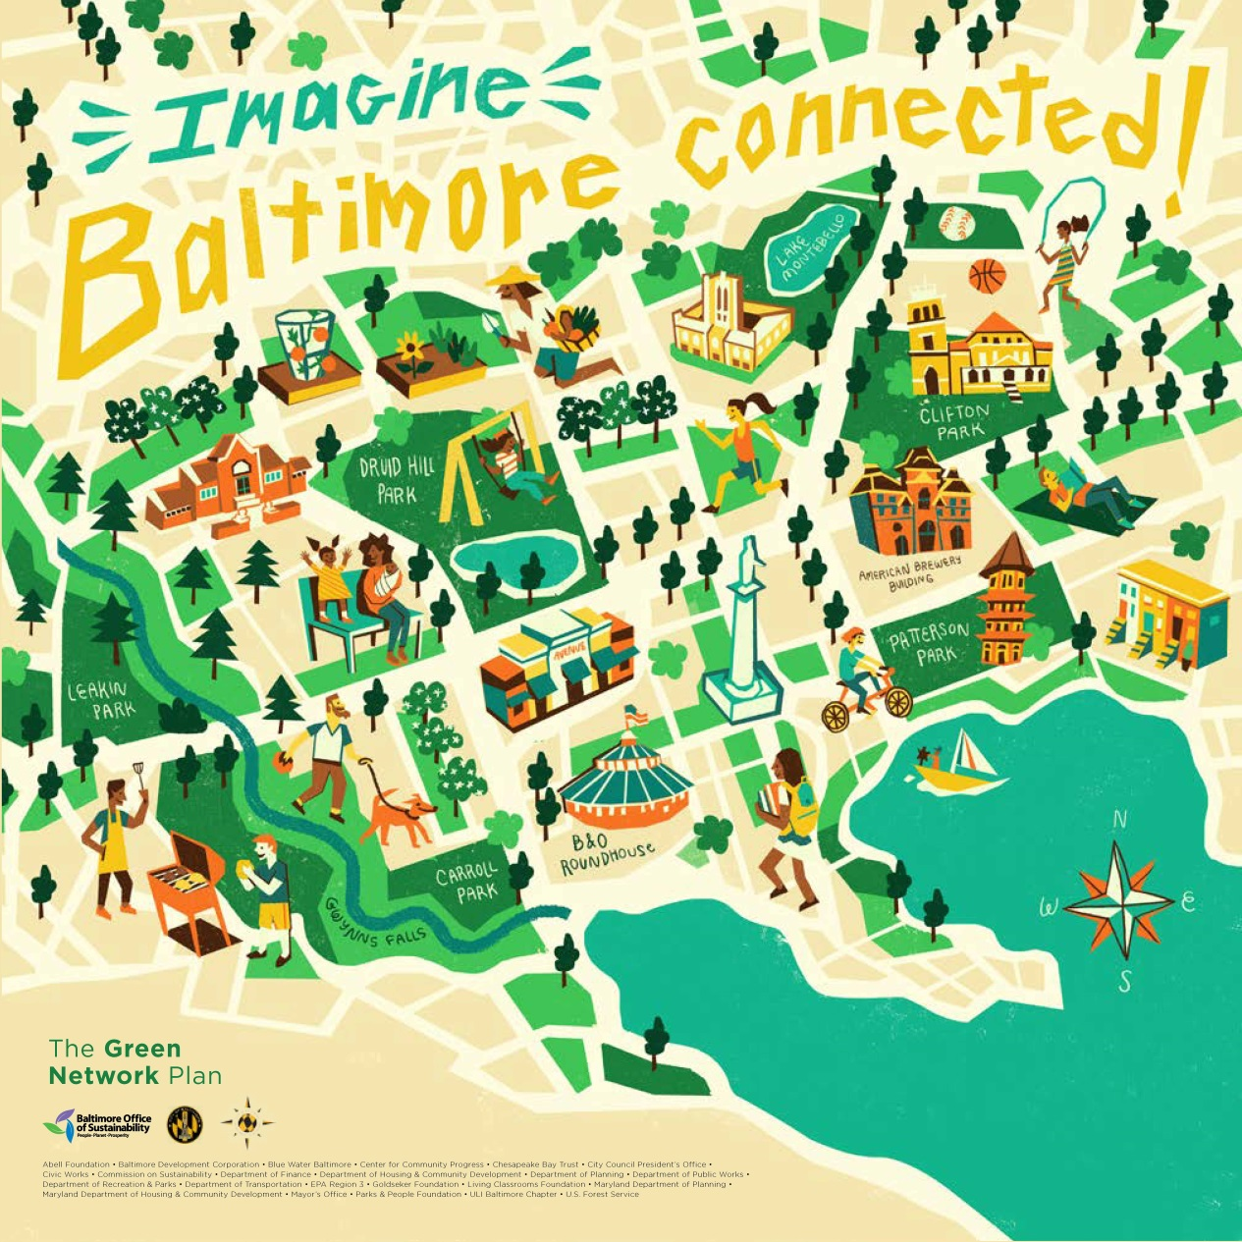

Slide 20
Future Areas for Policy Work
Indoor growing – our zoning and permitting regulations for urban agriculture were written with outdoor operations in mind. Indoor growing operations can be permitted as Light Industrial, but this greatly limits where they can locate.
Equity – while our new Sustainability Plan addresses the need to support historically disenfranchised communities, we need specific policies and practices in place to do so.
Immigrants and refugees – these populations often has a great deal of knowledge about agriculture, but is not adequately reached by existing outreach efforts.
Cannabis – the cannabis growing industry is not currently benefitting Baltimoreans but could be a huge economic boon; we must plan proactively to make this happen.

Slide 21
Resources

Slide 22
Resources
→ www.baltimoresustainability.org ←

Slide 23
Beginning Farmer Training Program

Slide 24
Black Church Food Security Network

Slide 25
Black Yield Institute

Slide 26
UME Master Gardeners

Slide 27
Baltimore Green Space

Slide 28
Land Access

Slide 29
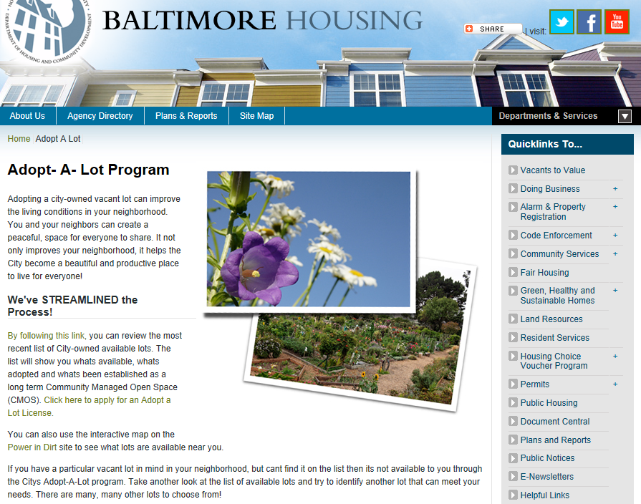
Adopt a Lot Program
http://www.baltimorehousing.org/adopt_a_lot

Slide 30
Adopt a Lot Program
Free
Provides you with a license to legally enter the property and conduct certain activities
Can technically be revoked at any time
Policy is to give one growing season’s notice before canceling the license

Slide 31
Homegrown Baltimore Land Leasing Initiative
&

Slide 32
Land Assessment
Conditions sought:
Contiguous
One acre or larger
City-owned
Flat
Open to the sun
No short to mid term development plans
Approximately 35 acres identified – most need a lot of prep and outreach!

Slide 33
Pre-Qualification Application https://www.baltimoresustainability.org/projects/baltimore-food-policy-initiative/homegrown-baltimore/urban-agriculture-2
Minimum qualifications:
At least 1 year of experience
Sustainable management plan
Openness to community involvement
Financially sound proposal
Terms:
Rolling deadline to apply
5-year leases (with 2-year notice to vacate), terms based on farm type
$100/year
Funding available to help with initial capital costs

Slide 34
Zoning and Permitting

Slide 35
What Changed?
Previously: Community gardens and urban farms were not technically permitted as permanent uses because there were no use categories for them. They were allowed as “temporary uses”.
Under new Code: Community gardens (aka Community-Managed Open Spaces) are a permitted use in most districts unless they incorporate certain features in which case they are conditional uses. Urban agriculture (aka farms) is a conditional use in most districts.

Slide 36
Definitions
Community-Managed Open Space. An open space area that is maintained by more than one (1) household and is used either for the cultivation of fruits, flowers, vegetables or ornamental plants; or as a community gathering space for passive or active recreation.

Slide 37
Definitions
Urban Agriculture. The cultivation, processing, and marketing of food, with a primary emphasis on operating as a business enterprise for income generation. Urban agriculture includes animal husbandry, aquaculture, agro-forestry, vineyards and wineries, and horticulture, and might involve the use of intensive production methods, structures for extended growing seasons, on-site sales of produce, and composting.

Slide 38
Where are they allowed?
Community-Managed Open Spaces are a permitted use in all zoning districts (unless they incorporate certain features) and Urban Agriculture will be a conditional use in all zoning districts with the exception of industrial zones, which are as follows:
OIC = Office-Industrial Campus BSC = Bio-Science Campus
I-MU = Industrial Mixed-Use I-1 = Light Industrial
I-2 = General Industrial MI = Maritime Industrial
 | OIC | BSC | I-MU | I-1 | I-2 | MI
CMOS | P | P | P
UA | P | P | P | P

Slide 39
What would make a garden conditional?
Community-Managed Open Space uses are conditional if they incorporate:
On-site composting
On-site sales, or
The keeping of animals.

Slide 40
Permitted Uses
A use permit is required before any person may use, for any purpose, previously-vacant land, or make any changes in the authorized use of any land or structure.
As long as use standards are met, permitted uses are allowed by default. An inspector will review your application and check in with other city agencies.

Slide 41
Permitted Uses
One-time filing/permit fee of $50-$100, depending on the complexity of your plans.
You must own the site or have permission from the owner, otherwise sites will continue to be considered “temporary uses”.

Slide 42
Conditional Uses
A use is conditional when the impact on the public must be considered on a case by case basis.
The Baltimore City Municipal Zoning and Appeals Board conducts a public hearing w/in 75 days of application. A notice of the hearing must be posted on the property by the applicant.

Slide 43
Conditional Uses
Conditional requests must be approved unless contrary to public interest, detrimental to public welfare, precluded by another law or Urban Renewal Plan, or not in harmony w/ the intent of the Code.
Considerations include traffic, future development, surrounding uses, accessibility, and preservation.

Slide 44
Conditional Uses
There is a one-time filing fee of $250. Up to $100 of additional fees may apply, depending on the complexity of your plans.
Conditions may be placed on a conditional use permit, such as on hours of operation, setbacks, and types of activities.

Slide 45
Use Standards: CMOS
(1) Limited to the cultivation of herbs, fruits, flowers, or vegetables, and may also include community gathering spaces for active or passive recreation, not including playgrounds.
(2) Keeping of livestock permitted as per Health Department regulations.
(3) For any cultivation of plants for human consumption, the applicant must use imported, clean soil OR soil testing is required and proposed remediation methodology, if needed, must be presented.
(4) Permanent structures are prohibited, but temporary greenhouses, sheds, gazebos, and pergolas, are permitted.
(5) One farmstand per zoning lot is permitted and is limited to sales of items grown at the site, must be stored when the site is not open for public use.

Slide 46
Use Standards: Urban Ag
(1) Urban ag uses that involving the following must submit a management plan for approval:
Animal husbandry
Processing of food produced on site.
Spreading of manure, sludge, or other nutrient-rich fertilizers.
Spraying of agricultural chemicals, including fertilizers, fungicides and pesticides.
Use of heavy equipment such as tractors.
(2) Greenhouses are permitted, either permanent or temporary.
(3) For any cultivation of plants for human consumption, the applicant must use imported, clean soil OR soil testing is required and proposed remediation methodology, if needed, must be presented.

Slide 47
Use Standards: Urban Ag (cont.)
(4) Permanent accessory structures limited to tool sheds, shade pavilions, barns, rest-room facilities, planting prep houses, and post-harvest processing facilities. Buildings must be set back 10 feet from lot lines and must be under 25 feet in height, except for structures designed to capture wind energy which may be taller.
(5) Combined area of all accessory structures limited to 25% of total lot area.
(6) Farmstands permitted, must be stored when the site is not open for public use.

Slide 48
Animal Husbandry

Slide 49
Updated in 2013
The Baltimore City Health Department regulates what animals may be kept in the city and the conditions required.
The “Regulations for Wild, Exotic, and Hybrid Animals” were updated in September 2013.
Full text here: www.baltimoresustainability.org/homegrown-baltimore-grow-local

Slide 50
Honey Bees
Register with the MD Dept. of Agriculture.
No more than 2 colonies and 1 nucleus colony on lots up to 2,500 square feet.
1 additional colony and 1 additional nucleus colony permitted for every additional 2,500 sf.
Inaccessible to the general public
At least 5’ from any lot line except where a solid wall/fence of at least 5’ high is a barrier)
Kept in such a way that they do not unreasonably interfere with surrounding uses and public right of ways.

Slide 51
Chickens
Register with the MD Dept. of Agriculture.
No more than 4 chickens over 1 month of age on lots smaller than 2,000 square feet.
1 additional chicken may be kept for every 1,000 sf up to a maximum total of 10.
Community gardens and urban farms may apply to keep more chickens, up to a total of 50. Must have a management plan.

Slide 52
Chickens
No roosters.
Sanitary and adequately sized coop or loft which must be clean, moved regularly, allows 2 sf per hen, provides shelter and shade, and is at least 15 feet from any residence.
Must be provided with fresh food and water and cared for if sick or injured.

Slide 53
Rabbits
On lots under 1,000 square feet, no more than 1 breeding pair and 12 rabbits total.
On lots over 1,000 sf, no more than 2 breeding pairs and 24 rabbits total.
Sanitary and adequately-sized enclosure or pen which must be clean, moved regularly, allows 3 sf per rabbit, provides shelter and shade, is at least 15 feet from any residence.
Must be provided with fresh food and water and cared for if sick or injured.

Slide 54
Goats
Must be miniature, dwarf, or pygmy breeds.
2 goats plus any offspring under 6 months of age on lots smaller than 20,000 square feet.
1 additional goat for every 5,000 sf after that up to a max. of 6.
Must be dehorned and, for male goats over the age of 6 months, neutered.
At least 150 square feet of permeable space each in fenced, graded, drained, and clean yard.
Must be provided with fresh food and water.

Slide 55
Special Rules
Must submit a permit application within 10 days of acquiring the animal(s).
Applicant and any employees can’t have been convicted of animal abuse, cruelty, or neglect
Must provide a photo and proof of any relevant vaccinations and health examinations (bees exempt).

Slide 56
Special Rules
Must have permission from property owner(s).
There is a one-time fee of $80 per animal type per address (bees exempt).
Permit is only valid for the location where the animals are normally housed (bees exempt).
Slaughter is prohibited.

Slide 57
What about fish?
Many other livestock animals, such as sheep, cows, etc. are specifically prohibited by the Health Code, but fish are not mentioned, meaning they may be kept without a city permit.
The Maryland Department of Natural Resources DOES regulate aquaculture for potential impacts on surrounding water bodies. There is a permit required, which is free.
Visit http://dnr.maryland.gov/fisheries/pages/aquaculture/nonshellfish.aspx to learn more.

Slide 58
Soils Issues

Slide 59
City Grading Permits
All disturbances of 5,000 square feet or more in Baltimore are required to receive a grading permit before work begins.
Grading permits require approval from the Department of Public Works.

Slide 60
City Grading Permits
Normally, the Department of Public Works requires 1) Stormwater Management and 2) Erosion & Sediment Control plans.
These can cost thousands of dollars to prepare and take months to process.

Slide 61
City Grading Permits
Agriculture is exempt from Stormwater Management and Erosion & Sediment Control UNDER CERTAIN CIRCUMSTANCES AND WITH OTHER PLANS SUBMITTED IN THEIR PLACE.
Structures are generally not exempt.
There will likely be special requirements if you are putting hoop houses on land that was formerly pervious (i.e. open soil/grass).

Slide 62
City Grading Permits
For guidance on your requirements, contact Rosanna LaPlante. Rosanna.Laplante@baltimorecity.gov or 410-396-0732.
For a grading permit: http://permits.baltimorecity.gov/ or call 410-396-3360 or visit the Permits One-Stop Shop on the first floor of the Charles L. Benton Building at 417 E. Fayette Street, 21202.

Slide 63
City Grading Permits
If you are exempted, you will need a Soil Conservation and Water Quality Plan instead.
Eric Hines of the Baltimore County Soil Conservation District can assist with the preparation of these plans. Eric.Hines@md.usda.gov or (410) 527-5920, ext. 2413

Slide 64
Soil Safety Management
Soils in Baltimore are safer than you might think! The Johns Hopkins Center for a Livable Future tested soil and produce at over 100 gardens and farms in Baltimore City, and only found four sites where lead was a concern. Their “Safe Urban Harvests” study
HOWEVER – soil testing is not optional! Just because contamination is relatively rare, doesn’t mean it couldn’t harm you.

Slide 65
Soil Safety Management
Under the new Zoning Code, Community-Managed Open Spaces and Urban Agriculture sites using existing soils will be required to submit a Soil Safety Plan.
This short document must include:
Site history
Information on what testing was done
Information on any mitigation to be done
Read the guidance document at https://www.baltimoresustainability.org/projects/baltimore-food-policy-initiative/homegrown-baltimore/urban-agriculture-2

Slide 66
State Nutrient Management Plans
Farms that gross over $2,500 per year are required by the State to create Nutrient Management Programs.
The Farm Alliance of Baltimore City, Real Food Farm, and the University of Maryland Extension may be able to provide info.
Learn more here: http://mda.maryland.gov/resource_conservation/Pages/farmer_information.aspx

Slide 67
Other policies

Slide 68
Other Policies
No building permits required for hoop houses.
Building permits are required for most other types of structures.
Water access available for $120/year: http://www.baltimorehousing.org/vtov_adopt

Slide 69
Taxes
Per State law, land used for agriculture is assessed at $500 per acre, resulting in a very low tax burden.
However, to qualify, sites must be at least three acres in size, which most city sites are not.

Slide 70
Taxes
Baltimore City has a 90% tax credit for urban agriculture.
Sites receiving the credit can’t be used for any other purpose that would normally be subject to property tax, such as housing.
Sites must remain a farm for five years or else pay back taxes.
Details: http://www.baltimoresustainability.org/projects/baltimore-food-policy-initiative/homegrown-baltimore/urban-agriculture-2/

Slide 71
How to Stay in the Loop
Contact: 410-396-1670 or abby.cocke@baltimorecity.gov
Website: www.baltimoresustainability.org
Commission on Sustainability Meetings: 4th Tues of every month, 4-6pm, 417 E. Fayette St., 8th floor
Facebook: www.facebook.com/baltimoresustainability
Twitter: @SustainBmore
Newsletter: Sign up on our website or email us at sustainability@baltimorecity.gov

