Slide 1
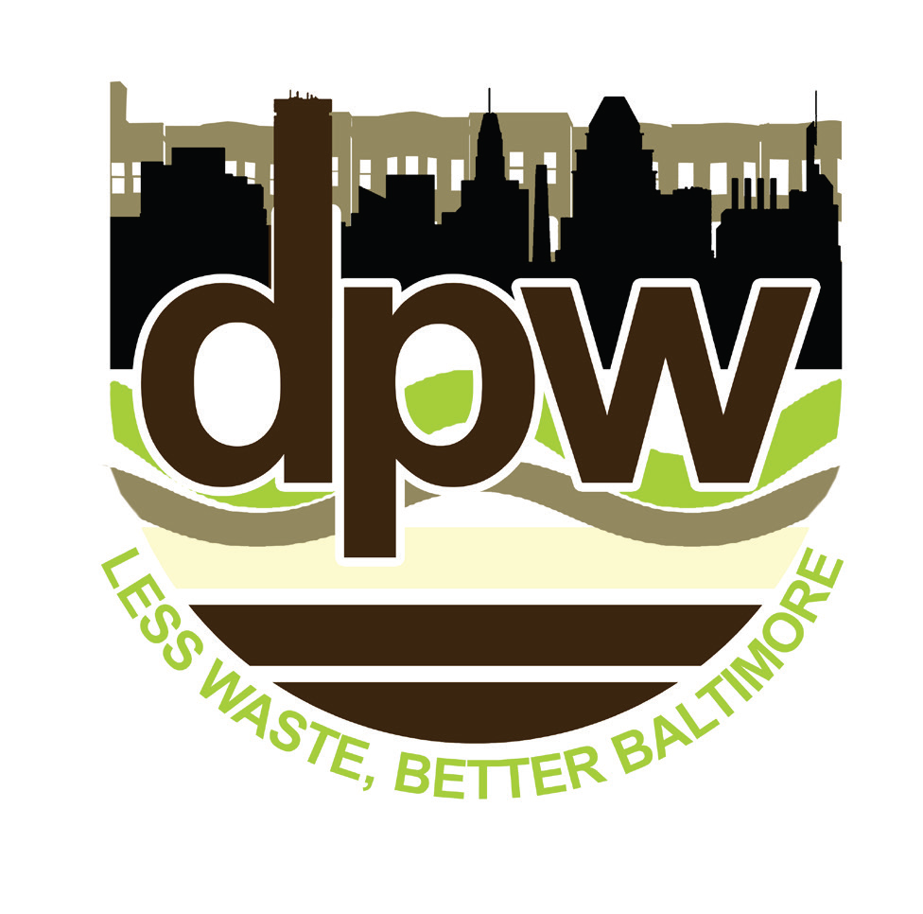

Less Waste, Better Baltimore
Rethinking our waste management future
Update on the LWBB Plan
20 November 2019
1

Slide 2
Outline
Review scope and progress on LWBB Plan
Review of recycling and diversion options
  Basis and methodology
  Options analysis
Summary of findings
2

Slide 3
LWBB Project Scope
Master planning effort through 2040+
Identify programs that could be implemented by DPW to:
Reduce the amount of waste generated
Maximize materials diversion, reuse, and recycling
Identify the best options for disposing of what’s left
3

Slide 4

Process for Plan Development and Execution
Winter/Summer Waste Sorts
Task 5
Review Options for Improving Waste Diversion
4x Community Meetings
Online Survey/Email Feedback
Assess Potential Impact on Waste Diversion Rate
Review of Baltimore’s Existing System
Benchmarking Against Other Cities
Task 7
Tasks 0 - 4
Handling What's Left
4

Slide 5
Options for Increasing Waste Diversion
How do we go about analyzing the City’s waste flows in order to understand how to reduce waste generation and divert more material from disposal?
→ Understand waste flows and materials
→ Look at what options are available and would be supported by residents and other stakeholders
→ Objectively assess different options in terms of expected performance
5

Slide 6
Options for Increasing Waste Diversion
How do we go about analyzing the City’s waste flows in order to understand how to reduce waste generation and divert more material from disposal?
→ Understand waste flows and materials
→ Look at what options are available and would be supported by residents and other stakeholders
→ Objectively assess different options in terms of expected performance
6

Slide 7
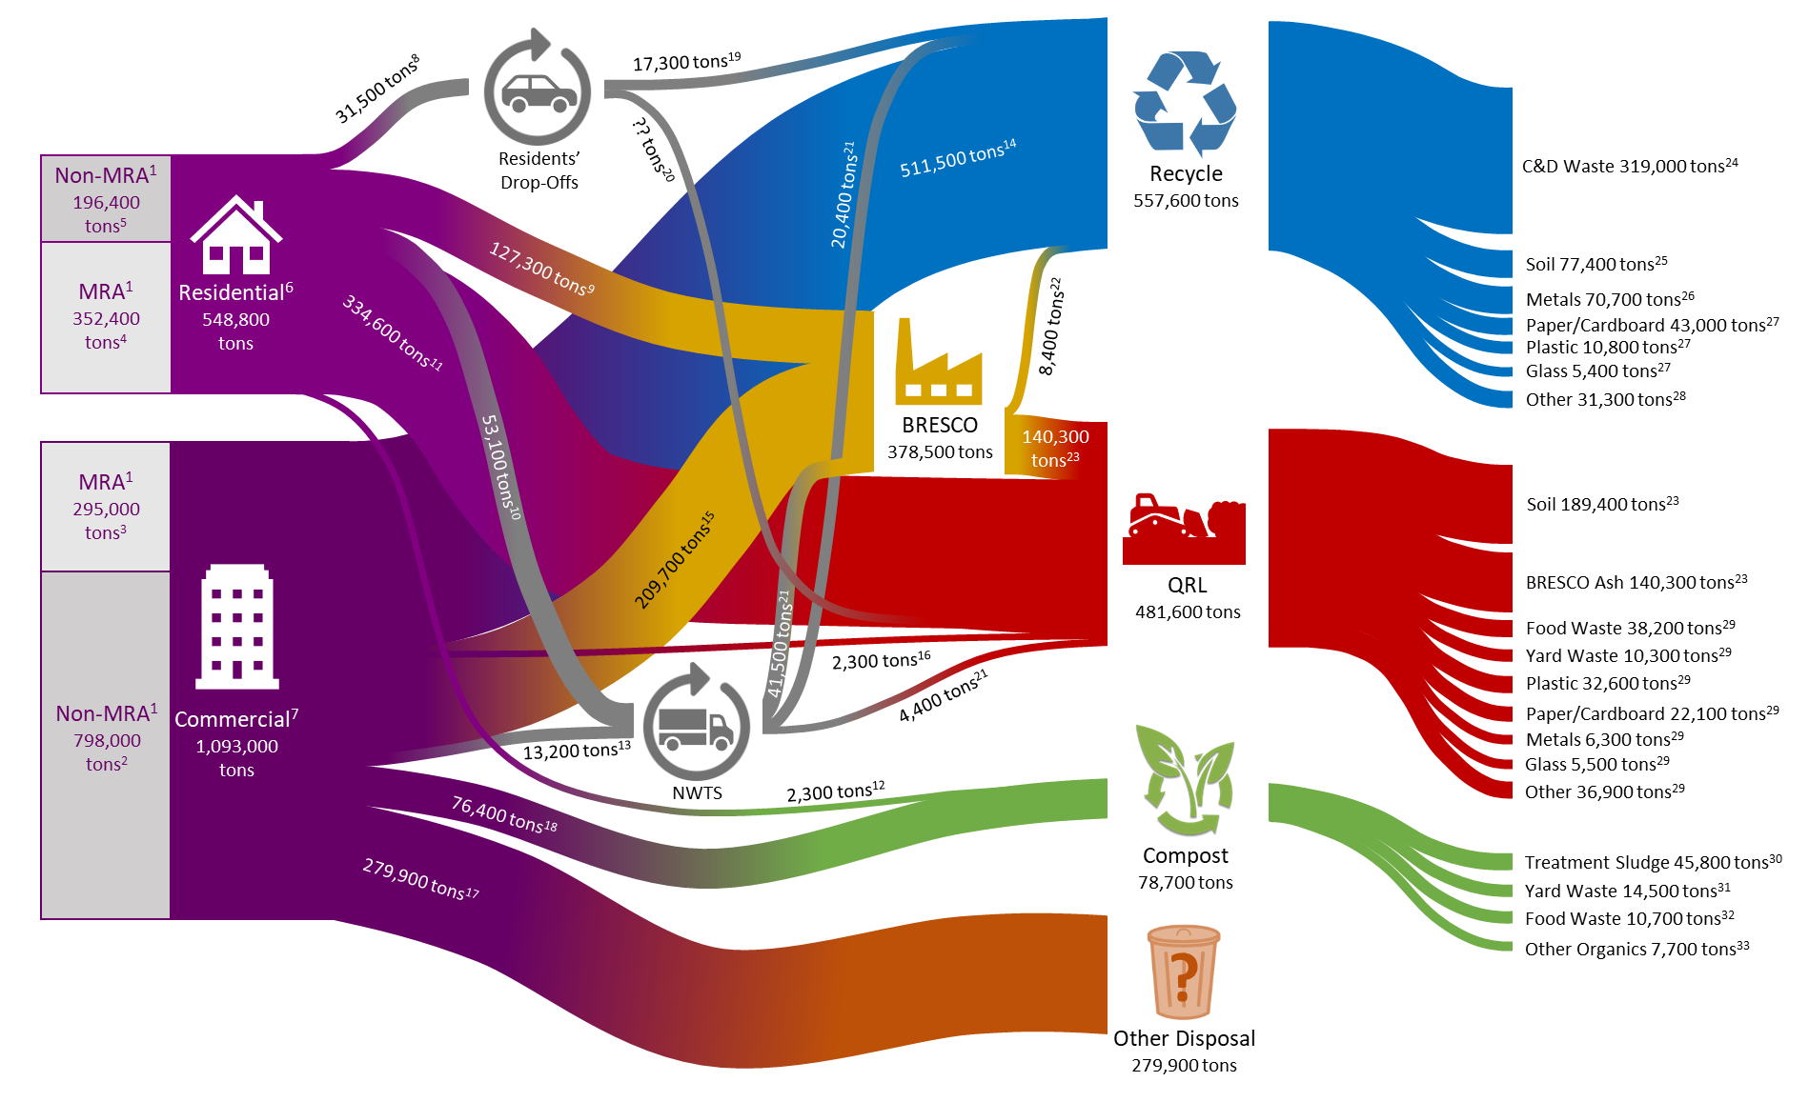
Waste Flows in Baltimore City
Current disposal flows that are the focus of this analysis
7

Slide 8
Estimated Quantities of Materials (2017-19 data)
Category | Residential Waste (tons) | Commercial Waste (tons) | Total (tons)
Total Disposal | 319,500 | 505,100 | 824,600
Food and Other Compostables | 101,700 | 61,500 | 163,200
Cardboard | 24,600 | 32,400 | 57,000
“Easy-to-Recycle” Materials | 34,000 | 28,600 | 62,600
“Hard-to-Recycle” Materials | 73,900 | 47,400 | 121,300
Lumber | 2,400 | 22,000 | 24,400
Other Mixed C&D Waste | 3,100 | 261,200 | 264,300
Bulky Waste, Mattresses, Carpets | 2,800 | 2,900 | 5,700
Unclassified (Disposal) | 77,000 | 49,300 | 126,300

Slide 9
Options for Increasing Waste Diversion
How do we go about analyzing the City’s waste flows in order to understand how to reduce waste generation and divert more material from disposal?
→ Understand waste flows and materials
→ Look at what options are available and would be supported by residents and other stakeholders
→ Objectively assess different options in terms of expected performance
9

Slide 10
Stakeholders Invited to Participate
Anchor Institutions
Businesses
Community organizers/leaders
Economic development partnerships
Elected officials
Environmental protection groups
Residents
Other City agencies/partnerships
Port Authority
Schools
Students
Waste management companies
10

Slide 11
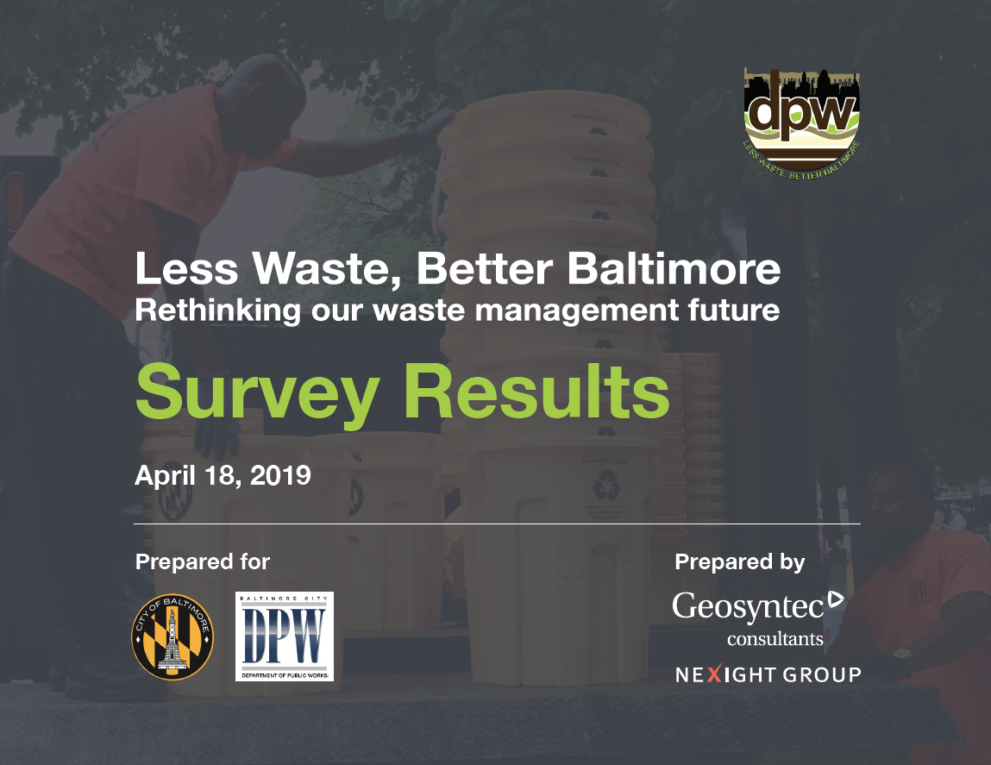
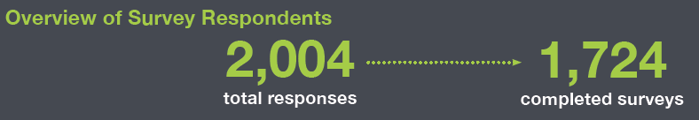
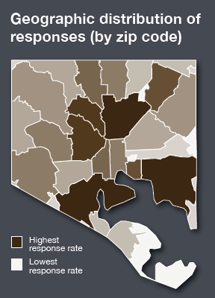

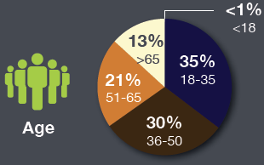
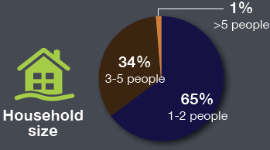
Public Input
11

Slide 12
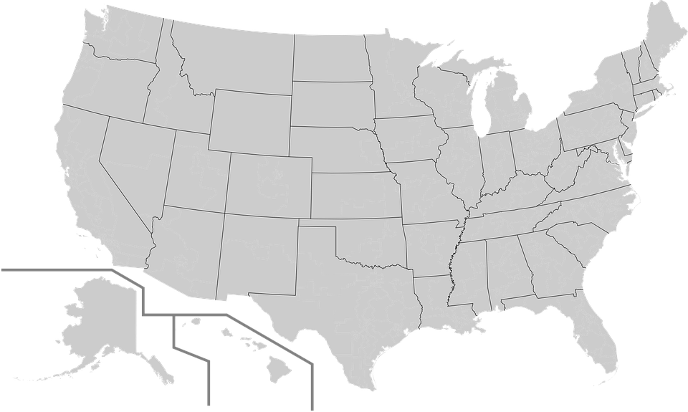
Benchmarking – Learning from Other Cities
Portland OR
Boston MA
Charlotte NC
Charleston SC
Austin TX
12

Slide 13
Options for Increasing Waste Diversion
How do we go about analyzing the City’s waste flows in order to understand how to reduce waste generation and divert more material from disposal?
→ Understand waste flows and materials
→ Look at what options are available and would be supported by residents and other stakeholders
→ Objectively assess different options in terms of expected performance
13

Slide 14
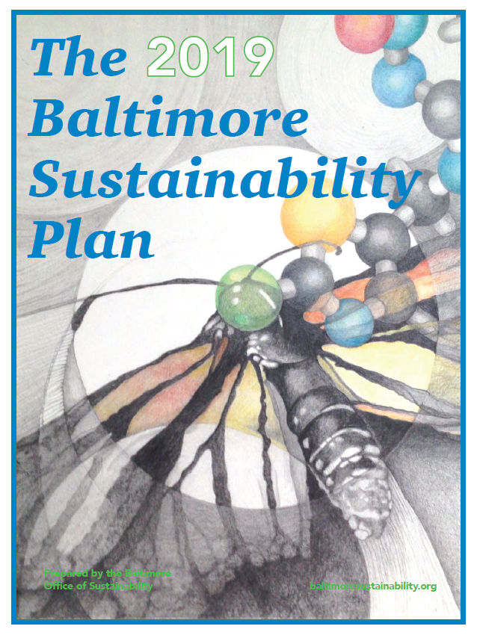
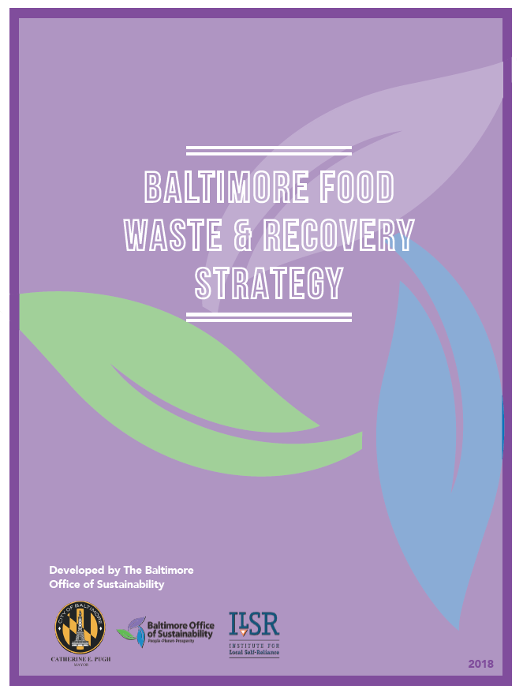
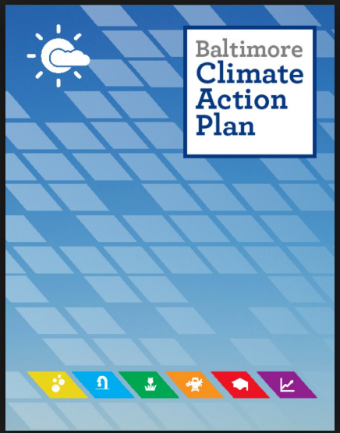
Baltimore City’s Strategic Plans
Zero waste goal of 90% diversion
Increase recycling
Reduce litter
Legislative and policy changes
Waste-to-Wealth Initiative:
Food waste
C&D waste
Wood
Goals for 2040
50% food waste reduction
80-90% diversion of food waste from disposal to composting and digestion
25% reduction in greenhouse gas emissions by 2020 and 30% reduction by 2025
14

Slide 15






Methodology for Assessment
Waste Diversion Potential:
Total tonnage
Materials
Interaction with Other Options
Benefits:
Social/Environmental
Greenhouse Gas Emissions
Job Creation
Revenue/Cost Offsets
Costs:
Capital
Operation and Maintenance
Labor
Challenges to Implementation:
Permits
Infrastructure and Land Required
Training
Timeline:
Short – Medium – Long Term
Time Lag before Seeing Benefits
Experience:
DPW’s Experience
Local Private Sector Experience
Other Jurisdictions
15

Slide 16
Analysis of Waste Recycling/Diversion Options
Task 5 of LWBB Plan
Draft Report Submitted to DPW on 30 Oct.
  Chapters 1 and 2 – Basis for Evaluation
  Chapter 3 – Food Waste and Organics
  Chapter 4 – “Traditional” Recyclables
  Chapter 5 – Construction and Demolition Waste
  Chapter 6 – “Non-Traditional” Recyclables
  Chapter 7 – Multi-Purpose Facilities
  Chapter 8 – “Soft” Infrastructure
  Chapter 9 – Operational and Administrative Improvements
  Chapter 10 – Summary of Findings

Slide 17
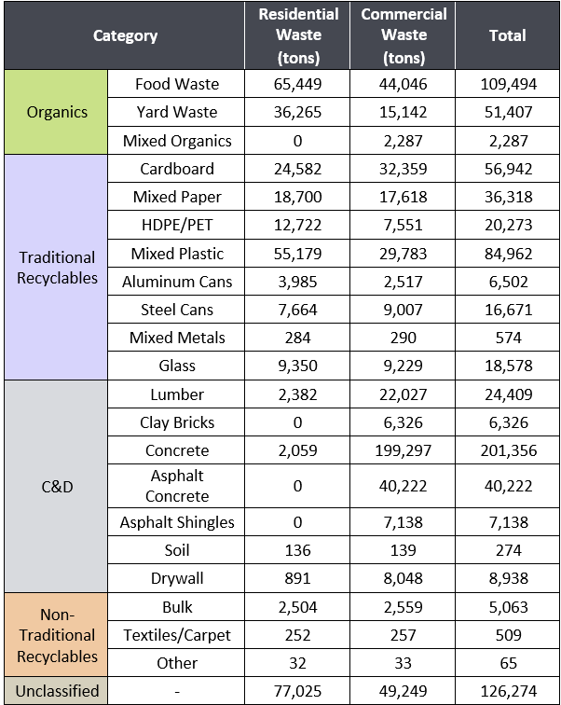
Ch. 2 – Assessment of Overall Divertability
DRAFT FINDINGS ONLY
Based on
2017 data
Total waste generated
1,641,800 tons
Recycled
738,500 tons
Composted
78,700 tons
Disposal
824,600 tons
~50%
Baltimore Sustainability Plan (BSP) states 90% diversion goal
Additional diversion required
= 40% of total (656,700 tons)
Potential Diversion
43% of total (698,300 tons)
BSP Goal for LWBB Plan
Disposal
17

Slide 18
Ch. 10 – Maximum Diversion Potential (MDP)
DRAFT FINDINGS ONLY
Chapter | Description | Universal Application | Food Waste Strategy |  | C&D Waste Strategy
 |  |  | A | B | A | B
3.1 | Food Waste Reduction |  | - | 72,400
3.2 | Residential Organics Composting |  | 81,800 | 42,800
3.3 | Commercial Organics Composting |  | 59,200 | 35,500
4 | Traditional Recyclables | 153,500
5.1 | C&D Reuse |  |  |  | - | 28,400
5.2 | C&D Diversion |  |  |  | 216,900 | 200,100
6.1 | Bulk Waste | 4,000
7.1 | Expand Residents’ Drop-offs | 16,100
10 | Subtotal | 173,600 | 141,000 | 150,700 | 216,900 | 228.5k
Available Diversion = Universal + A/B from Food Waste Strategy + A/B from C&D Waste Strategy
Maximum Diversion Potential (MDP) Highlighted in Red = 173.6k + 150.7k + 228.5k = 552.8k tons
Achieving MDP would increase overall waste diversion to 83% (552.8k + 738.5k + 78.7k / 1641.8k = 0.83)
18

Slide 19
Ch. 10 – Direct Cost and Benefits (for MDP)
DRAFT FINDINGS ONLY
Chapter | Description | CAPEX $/ton |  | OPEX^{A} $/ton |  | Job Creation Potential |  | GHG Reduction MTCO2E
 |  | DPW | Total | DPW | Total | DPW | Others
3.1 | Food Waste Reduction | -- | $687 | $65 | $3,415 | 3 | not calc. | 305,000
3.2 | Residential Organics | $166 | $415 | $146 | $230 | -- | 40^{C} | 4,500
3.3 | Commercial Organics | -- | $331 | $8 | $197 | 3 | 70^{C} | 800
4 | Traditional Recyclables | $128 | $236 | $120 | $184 | 4 | 120^{C} | 349,700
5.1 | C&D Reuse | -- | -- | $5 | $5^{B} | 3 | --^{B} | 25,000
5.2 | C&D Diversion | -- | $103 | -- | $91^{B} | -- | 30^{B,C} | 32,700
6.1 | Bulk Waste | -- | -- | $12 | $12^{B} | 6 | 6^{B,C} | 11,400
7.1 | Resid. Drop-offs | $12 | $12 | $22 | $22 | 6 | 6^{C} | 25,800
10 | All | $262 (weighted avg.) |  | $563 (weighted avg.) |  | 25 | ~270 | 754,900
A: excl. revenues from sale of recovered materials, tip fees; B: excl. secondary job creation; C: excl. job losses at disposal facilities
19

Slide 20
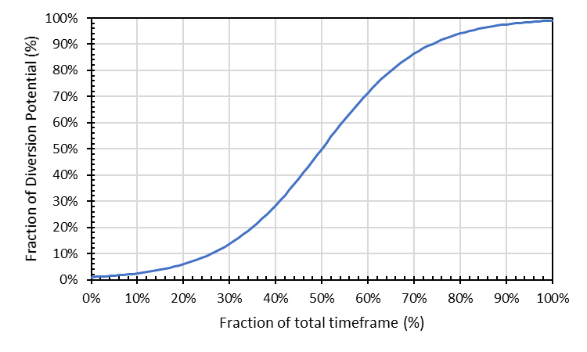
Ch. 10 – Timeline and Phasing (for MDP)
DRAFT FINDINGS ONLY
Chapter | Diversion Option | Timeframe (years) | Diversion Potential (tons)
3.1 | FW Red. | 20 | 0k or 72.4k
3.2 | Resid. Org. | 20 | 81.8k or 42.8k
3.3 | Comm. Org. | 20 | 59.2k or 35.5k
4.2 | Trad. Recyc. | 10 | 153.5k
5.1 | C&D Reuse | 10 | 0k or 28.4k
5.2 | C&D Div. | 20 | 216.9k or 200.2k
6.1 | Bulk Waste | 10 | 4k
7.1 | Res. Dropoff | 5 | 16.1k
Timeframe for achieving Max. Diversion Potential (MDP) for each Option
Assumed S-Curve Uptake Rate for each Option
Example:
How much additional diversion of Trad. Recyclables is expected under the MDP in 2032 if the program starts in 2025?
→ 10-year implementation timeframe. S-Curve: 0% = 2025, 100% = 2035. 2032 = 7 years in. 7YR/10YR = 70%
→ 70% of timeframe = 85% of diversion potential. 85% x 153.5k = 130.5k tons.
20

Slide 21
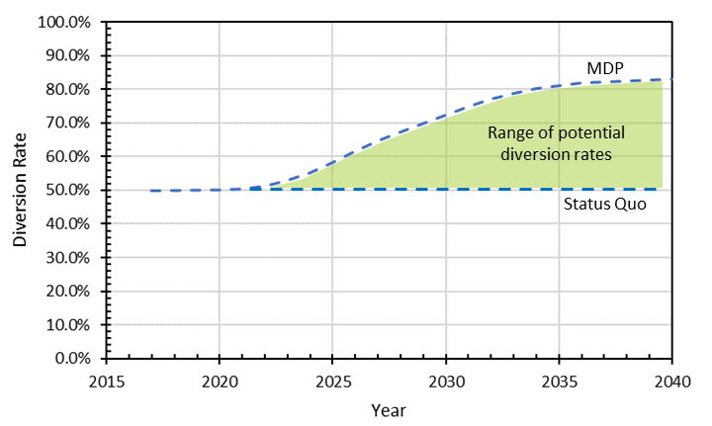
Ch. 10 – Range of Diversion Outcomes
DRAFT FINDINGS ONLY
Range of Potential Diversion Rates
(depending on when each option starts and how successful it is)
21

Slide 22
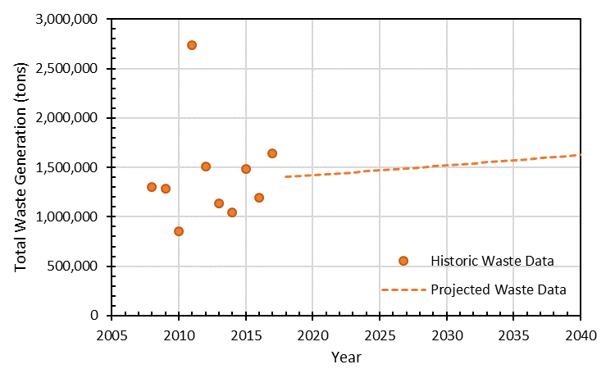
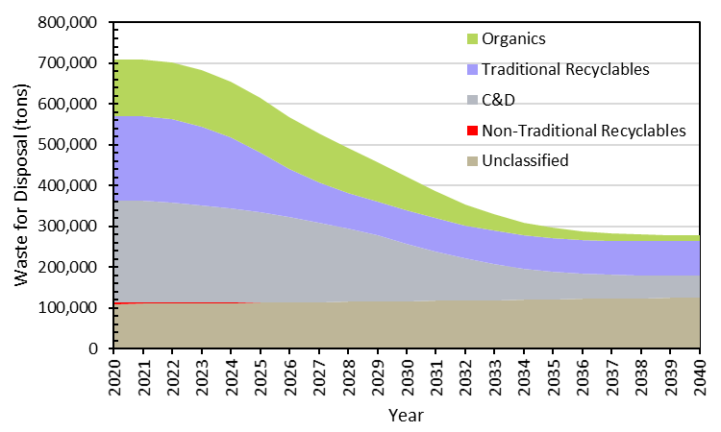
Ch. 10 – What’s Left for Disposal under MDP
DRAFT FINDINGS ONLY
2017
Historical and Projected Waste Generation
(growth projection = 0.7% per year)
What’s Left for Disposal
(assuming the City achieves MDP by 2040)
(assuming 0.7% annual growth in all waste streams)
22

Slide 23
Ch. 10 – Range of Disposal Outcomes (Citywide)
DRAFT FINDINGS ONLY
Looking forward to Task 7: What does this mean for the City’s disposal needs?
MDP | 2020 | 2025 | 2030 | 2035 | 2040
0% | 463,700 | 479,700 | 496,200 | 513,200 | 530,800
20% | 463,200 | 462,100 | 453,600 | 465,900 | 483,100
40% | 462,600 | 444,600 | 410,700 | 413,900 | 428,600
60% | 462,100 | 427,200 | 367,400 | 357,000 | 367,300
80% | 461,600 | 409,900 | 323,700 | 295,200 | 299,200
100% | 461,000 | 392,700 | 279,500 | 228,700 | 224,400
MDP | 2020 | 2025 | 2030 | 2035 | 2040
0% | 249,800 | 258,400 | 267,200 | 276,400 | 285,900
20% | 249,400 | 251,000 | 241,200 | 225,000 | 226,000
40% | 249,000 | 243,500 | 215,500 | 178,400 | 172,700
60% | 248,500 | 236,000 | 190,300 | 136,600 | 126,300
80% | 248,100 | 228,300 | 165,500 | 99,600 | 86,600
100% | 247,700 | 220,500 | 141,000 | 67,500 | 53,700
Expected MSW Disposal Tonnages under Various Diversion Rates as a Percentage of the MDP
(0% represents Status Quo)
Expected C&D Disposal Tonnages under Various Diversion Rates as a Percentage of the MDP
(0% represents Status Quo)

Slide 24
Ch. 10 – Range of Outcomes for DPW
DRAFT FINDINGS ONLY
What does this mean for DPW’s collection and disposal needs?
MDP | 2020 | 2025 | 2030 | 2035 | 2040
0% | 31,600 | 32,700 | 33,800 | 34,900 | 36,100
20% | 31,900 | 43,400 | 60,300 | 69,100 | 71,800
40% | 32,300 | 54,100 | 86,700 | 103,200 | 107,400
60% | 32,600 | 64,900 | 113,200 | 137,300 | 143,000
80% | 33,000 | 75,600 | 139,700 | 171,500 | 178,600
100% | 33,400 | 86,400 | 166,200 | 205,600 | 214,300
MDP | 2020 | 2025 | 2030 | 2035 | 2040
0% | 271,700 | 281,000 | 290,700 | 300,700 | 311,000
20% | 271,300 | 270,300 | 264,200 | 266,600 | 275,400
40% | 271,000 | 259,600 | 237,700 | 232,400 | 239,800
60% | 270,600 | 248,800 | 211,300 | 198,300 | 204,200
80% | 270,300 | 238,100 | 184,800 | 164,100 | 168,500
100% | 269,900 | 227,300 | 158,300 | 130,000 | 132,900
RECYCLING + ORGANICS
Expected DPW curbside collection (tons) under Various Diversion Rates as a Percentage of the MDP
(0% represents Status Quo)
TRASH FOR DISPOSAL
Expected DPW curbside trash collection (tons) under Various Diversion Rates as a Percentage of the MDP
(0% represents Status Quo)

Slide 25
Thank You
Less Waste, Better Baltimore
Rethinking our waste management future
publicworks.baltimorecity.gov/lesswaste
25

