Slide 1
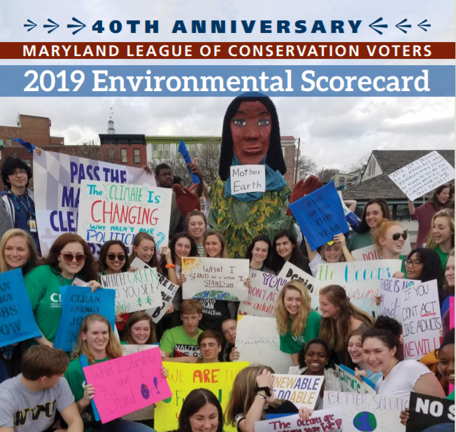

Maryland LCV
The Political Voice of the Environment
maximizing participation
build strength and power
of conservation-minded voters
Notes:
Talk about Maryland LCV and Maryland LCV Ed fund. Our scorecards, what we do, ect.

Slide 3
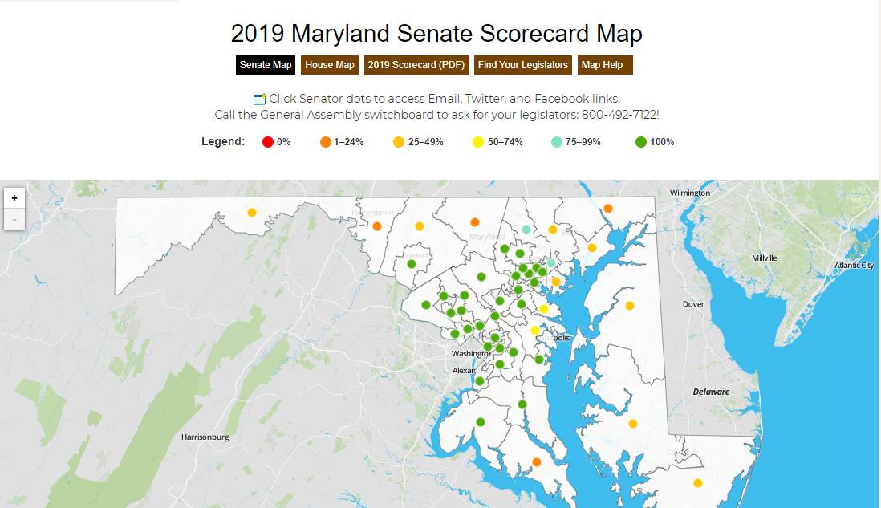

Slide 4

Electric Vehicle Infrastructure
100% zero-emission busses by 2030
Expand charging station infrastructure

Slide 5
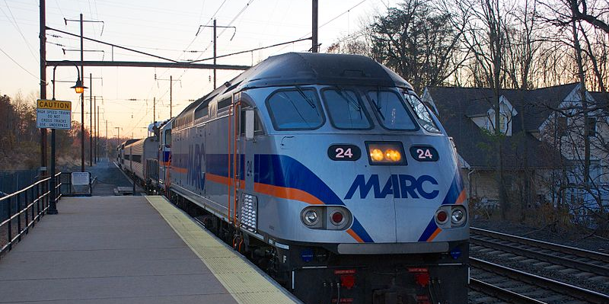
Public Transit Funding & Transportation Climate Initiative
Notes:
Funding the $2 billion MTA shortful and require MDOT to eliminate the backlog of repairs over the next six years. Expand MARC.
Equity Implications: Electrification of transit, especially busses, would ease the diesel air pollution from buses that is especially concentrated in low income communities and communities of color. Similarly, ridership is largely lower-income residents, whose exposure through riding the buses is higher. As a cap-and-invest program, TCI is an opportunity to direct funding to environmental justice communities, although there are risks that if not well crafted and well implemented, it could prove recessive.

Slide 6
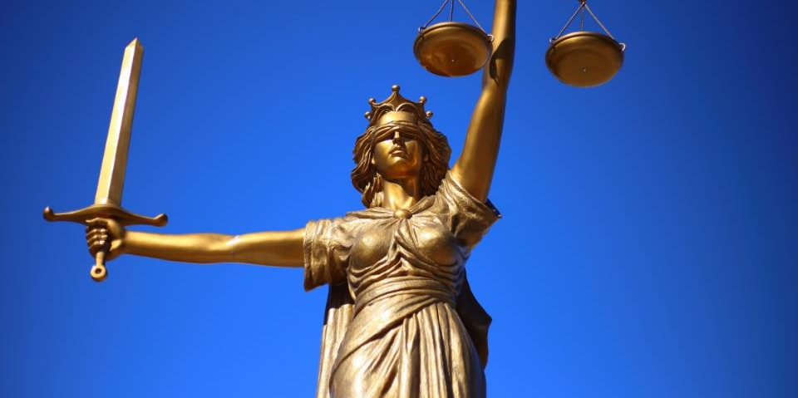
Enforcement Ombudsman
Notes:
Ombudsman Enforcement:
Staff Lead: Kristen
Sponsors: Lierman/Elfreth
Likely Committee: APP/BAT
Partners: Waterkeepers Chesapeake/Center for Progressive Reform/ Chesapeake Legal Alliance
What bill does: Creates a ombudsman position in the Office of the Attorney General to aid in departmental transparency and enforcement in the Departments of Environment, Natural Resources, and Agriculture.
Equity Implications: State agencies do not have the resources to adequately provide transparency to communities about the violations in their area, the permits that are being considered or which are extended or expired, and it is difficult for them to navigate the bureaucracy to make claims of environmental degradation from bad actors. This bill seeks to fix that, which will ensure that agencies are better able to serve disadvantaged communities.

Slide 7

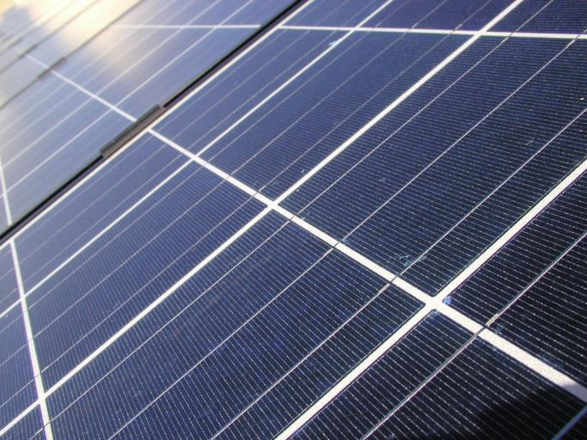

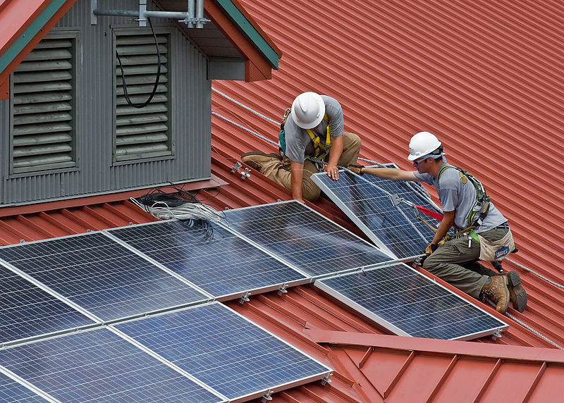
Greenhouse Gas Reduction Act
Reform
Need to reduce emissions faster
Based on current UN report on climate change
Notes:
What bill does: Seeks to update the 2016 Greenhouse Gas Reduction Act goals to reflect the current requirements outlined by the UN report on climate change. Additionally, it proposes changes to the Maryland Climate Commission to ensure efficacy and improving regulatory authority.
Equity implications: The current GGRA does not include protections for workers in transition from fossil fuel jobs into a clean economy, or provide any detail on how frontline and disadvantaged communities will see an equitable share of resources in such a transition. Both of these pieces are necessary to ensure our reduced carbon state is also an improved justice state.
Outlook: Uncertain, since the issue is new, but it has the potential to be a high profile and signature issue of the session.

Slide 8

Banning Chlorpyrifos pesticides
Notes:
Among the populations impacted by remaining agricultural use of chlorpyrifos are migrant farm workers, who are likely exposed to the fruits and vegetables treated with the chemical and carrying it back on their shoes and clothing to their families, perpetuating additional negative health effects on already vulnerable populations.

Slide 9
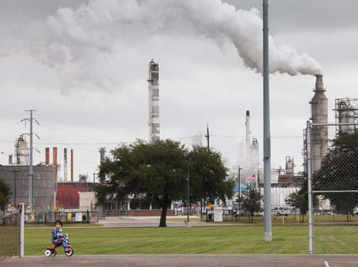
Carbon Cost Collection
Fee on carbon at the point of sale
Rebates for low-income residents
Revenue for education funding
Notes:
What bill does: Sets a fee on carbon at the point of sale, with rebates for low-income residents. Revenue may be tied to education funding required by the Kirwin Commission.
Equity Implications: Low-income Marylanders would stand to receive rebate checks from the price on carbon of high-cost purchases of wealthier residents to offset additional costs.

Slide 10
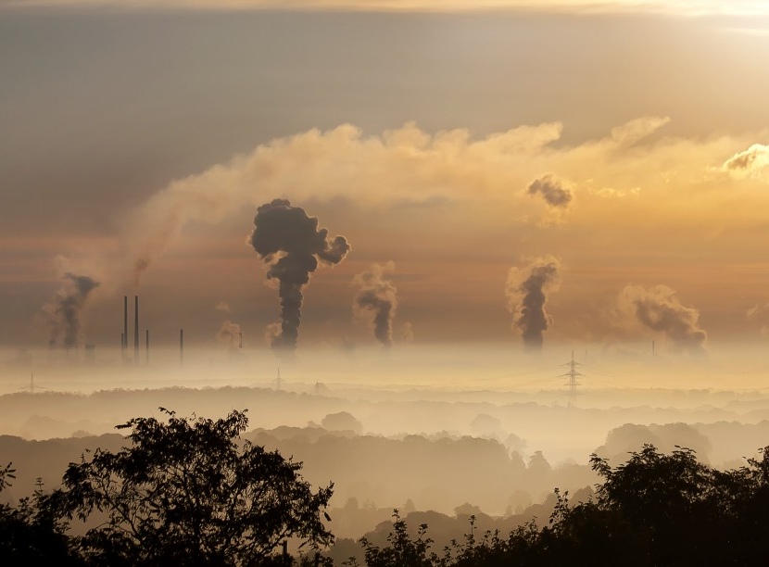
Renewable Portfolio Standard
Clean Up
Notes:
Sponsors: Davis/Uncertain
Committee: ECM/FIN
Partners: Clean Water Action, Sierra Club, CCAN
What bill does: Removes waste incineration as tier one qualified sources within Maryland’s Renewable Portfolio Standard.
Equity Implications: The BRESCO waste incinerator in Baltimore is linked to significant negative health impacts to disadvantaged communities surrounding it. While removing the subsidy does not on its own force the facility to close, removing the state subsidy would allow the moneys to be spent on cleaner energy sources, and encourage the facilities to substantially improve their emissions standards to continue operating. The potential improvement to the surrounding communities could be dramatic.

Slide 11
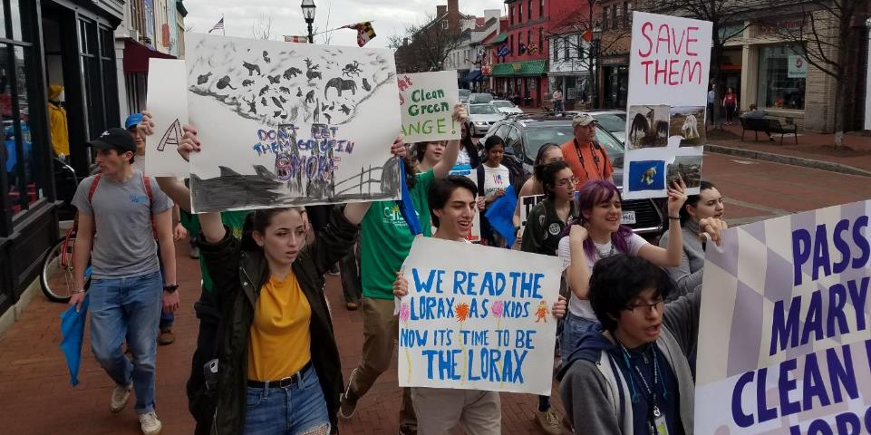
Coal phase out
Notes:
Staff Lead:: Ramon or Kristen
Sponsors: Barve/(Lam or West Pinsky)
Committee: ECM/FIN
Partners: Sierra Club leading a coalition
What bill does: Sets a timeline for retirement of all six coal-fired power plants, with consideration for community and worker impact.
Equity Implications: The six remaining coal-fired power plants in Maryland are situated in communities already economically disadvantaged and disproportionately impacted by industrial environmental degradation. Creating a timeline for closing these plants has the potential to dramatically improve the air quality in these areas, however attention will need to be paid to assist communities and workers transition from fossil fuel-based employment to a clean energy economy.

Slide 12
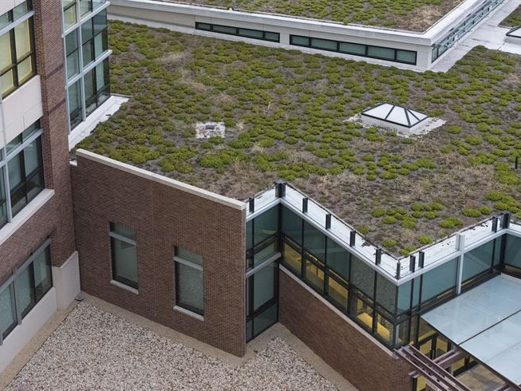
Building Code and Regulations
3 bills:
Changes zoning restrictions near transit
Encourage carbon-neutral construction
Encourage carbon-neutral renovations
Notes:
Sponsors: Stewart/Uncertain
Committee: ENT/EHE
Partners: To Be Determined
What bill does: Three bills: One changes zoning restrictions against multi-home structures near transit, one would mandate or encourages carbon-neutrality in new construction, one would encourage carbon-neutral renovations on existing buildings.

Slide 13
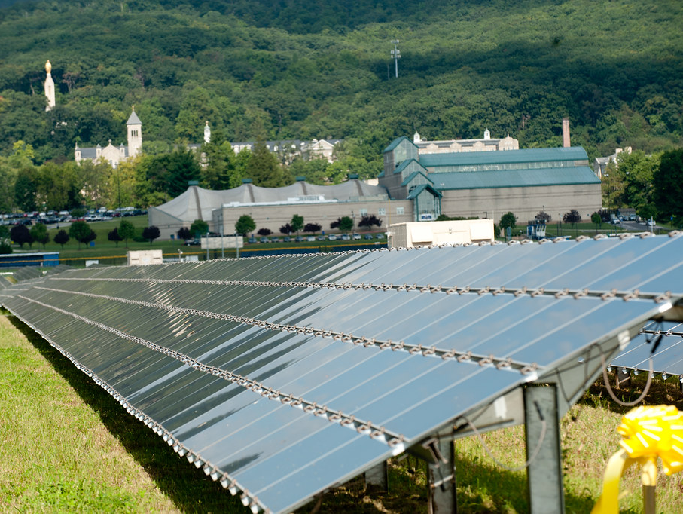
Solar Siting
Notes:
Sponsors: (Pinsky)/(Stein)
Committee: ENT/EHE
What bill does: Addresses the regulatory, land use, and financial concerns surrounding the expansion of utility-grade and community solar projects.

Slide 14
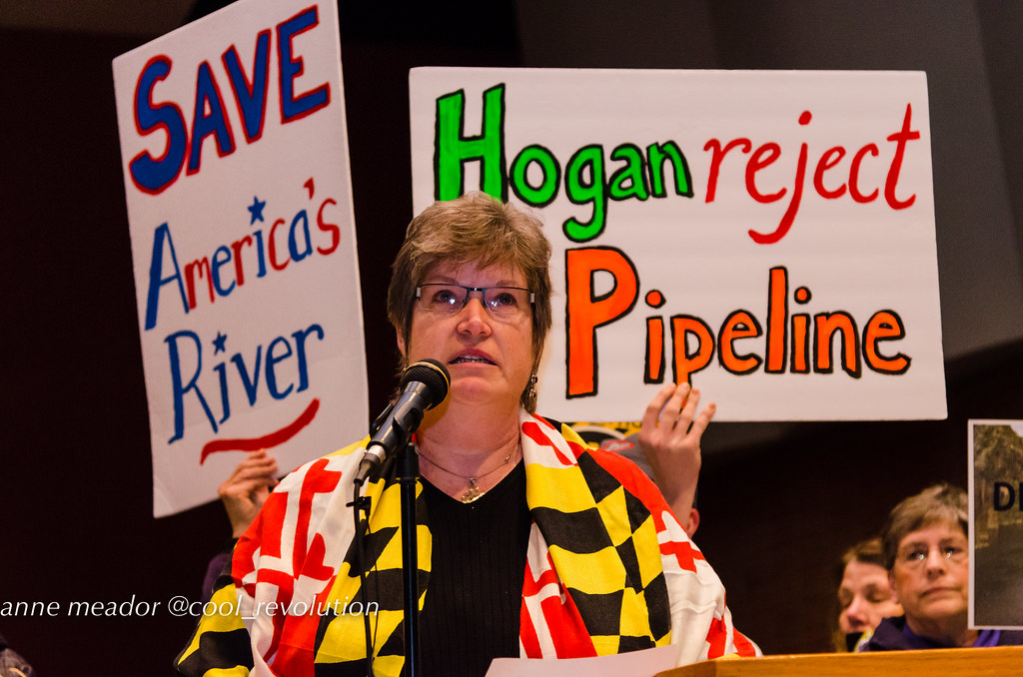
Fossil Fuel Infrastructure
Notes:
Sponsors: Uncertain
Committee: ECM/FIN
Partners: CCAN
What bill does: Bans (or puts a moratorium) on new fossil fuel infrastructure in the State of Maryland.
Equity Implications: Fossil fuel infrastructure is disproportionately sited in low-income communities and communities of color, which leads to similarly disproportionate negative health impacts and risks of water and air contamination.
Outlook: Poor. This will always hit huge opposition, questions on interstate commerce, and technical questions. We have periodically opposed specific infrastructure changes, but not across-the-board.
Effort Recommendation: Limited.
Staff Lead: None
11/12/19 Update: No substantive updates. CCAN continues to push this legislation, however their priority is solidly with the GGRA reform.
12/9/19 Update: No substantive updates.

Slide 15
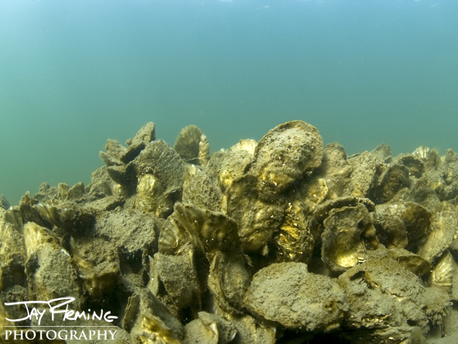
Protecting Oysters
Veto override
Notes:
Veto override:
Gov. Larry Hogan vetoed bipartisan legislation passed by the General Assembly that would have created a consensus-based process to develop a new oyster fishery management plan for Maryland. The veto of HB720/SB830 comes after Gov. Hogan vetoed another oyster-related bill to permanently protect five oyster restoration tributaries from harvest. The governor’s veto of the tributary bill was later overridden by the legislature.
Like that bill, the consensus fishery management plan received enough votes from legislators to override the governor’s veto. The Chesapeake Bay Foundation supports the fishery management bill because we believe it offers the best chance at creating a plan that satisfies the diverse interests of environmentalists, watermen, oyster farmers, and seafood dealers.
The General Assembly will not have a chance to override the veto until its next session begins in January 2020, unless a special session is called. By issuing the veto, the governor is setting aside a collaborative process that calls for using the latest science to identify sustainable oyster management tools.
A new plan must be developed after the state’s new oyster stock assessment determined the oyster population in the Maryland portion of the Bay dropped from 600 million adult oysters in 1999 to 300 million in 2018. The assessment also found oysters in nearly half of the harvest areas in Maryland’s portion of the Bay were being overharvested.
Outlook: Uncertain – The (Democratic) General Assembly has largely been supportive of oyster fisheries protection legislation, however the consistent gubernatorial overrides in that arena may lead to some fatigue by even the staunchest allies. The outlook will depend entirely on what the bill does. CBF is working with Chairman Pinsky to craft legislation, but the details are still pending.

Slide 16
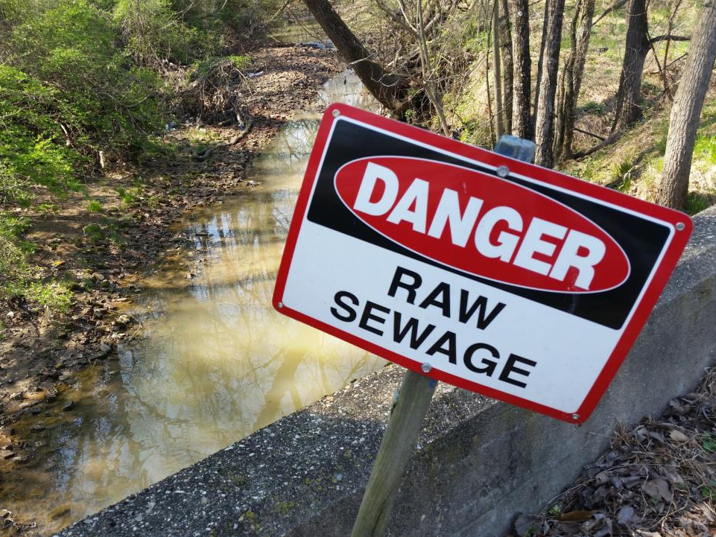
Septic bills
Notes:
CUT FOR TIME
As have time:
2 septic bills
Veto overrides:
Bikeways override
2 person train crew

Slide 17
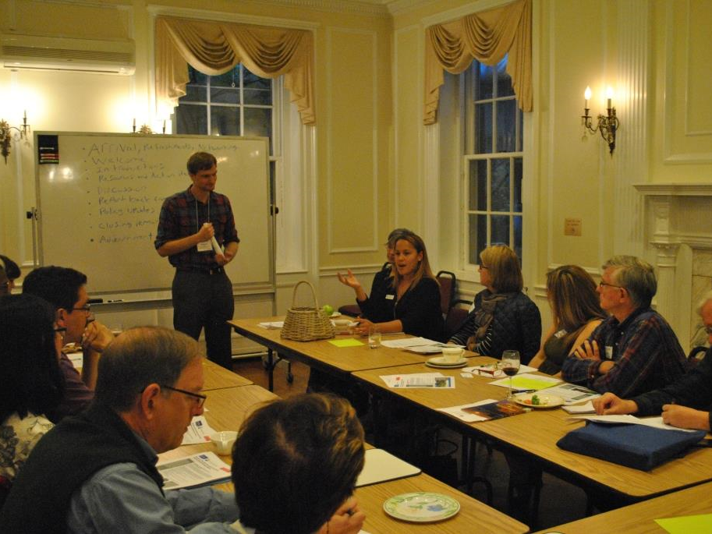
Discussion Time
Ben Alexandro
Water Program Director
Maryland League of Conservation Voters
Balexandro@mdlcv.org
410-280-9855 X 204

