Slide 1

Meeting Baltimore City’s Sustainability Goals
Education & Awareness Goal #1: Turn Every School in Baltimore City into a Green School

Slide 2
Theory of Change
Providing resources and incentives to schools
Building Student Leadership
A Green School System in Baltimore
Changing Internal Systems
Developing Partnerships
Developing Outside Partnerships

Slide 3





Slide 4
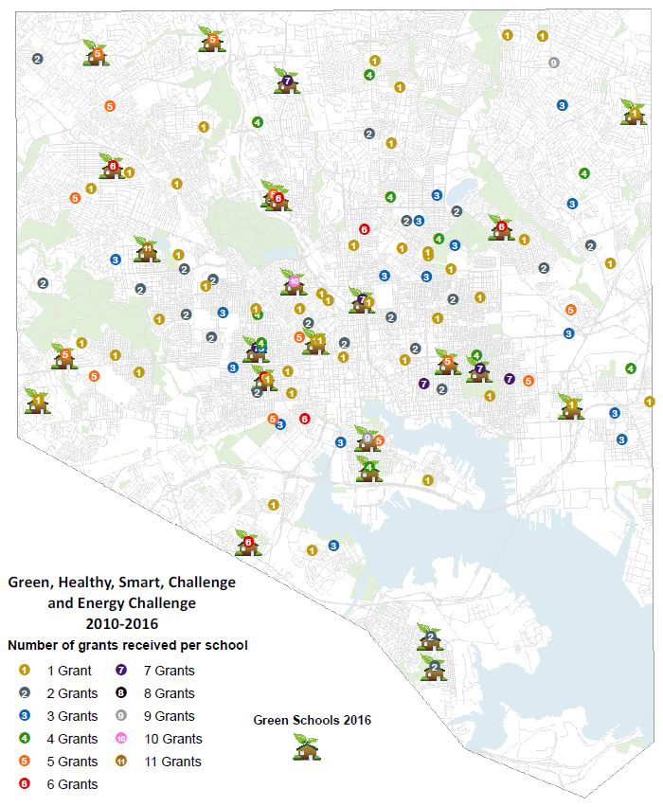
Providing Resources and Incentives to Schools

Slide 5
Providing Resources & Incentives
Grants, Awards, and Programs 2015-2016
  57 Green, Healthy, Smart Challenge grants
  23 Energy Hub grants
80 grants to 64 schools, totaling $106,884
16 brand new Schools participating
758 Junior Energy Captains and Green Team members
31 teachers receiving Green Leader Achievement Units
131 Schools engaged in our programming since its inception; 67% of public schools

Slide 6
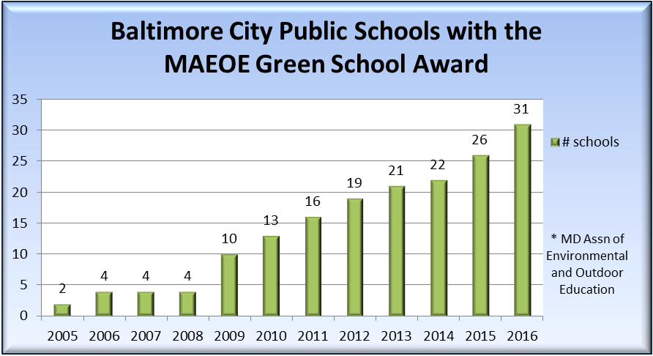
Providing Resources & Incentives
Maryland Green Schools Program in 2016
Consulted with 9 schools
5 successful new certifications!
31 Baltimore City Public Schools are now Maryland Certified Green Schools,
17% of all public schools in Baltimore City

Slide 7
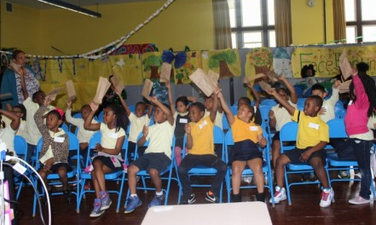
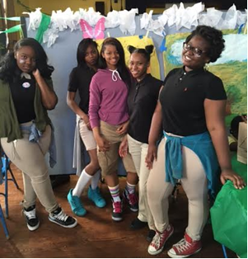
Providing Resources & Incentives
  Snapshot: Arlington Elementary/ Middle School
  10 new garden beds, 2 field trips, campus cleanup, 2 school-wide Power Down Days, 15 One-Switch Wednesday, and a Green Day event.
  “This is the most challenging project I have ever worked on. But in the end it felt so good to make other kids so happy.” – Octavia G., 8th Grade

Slide 8
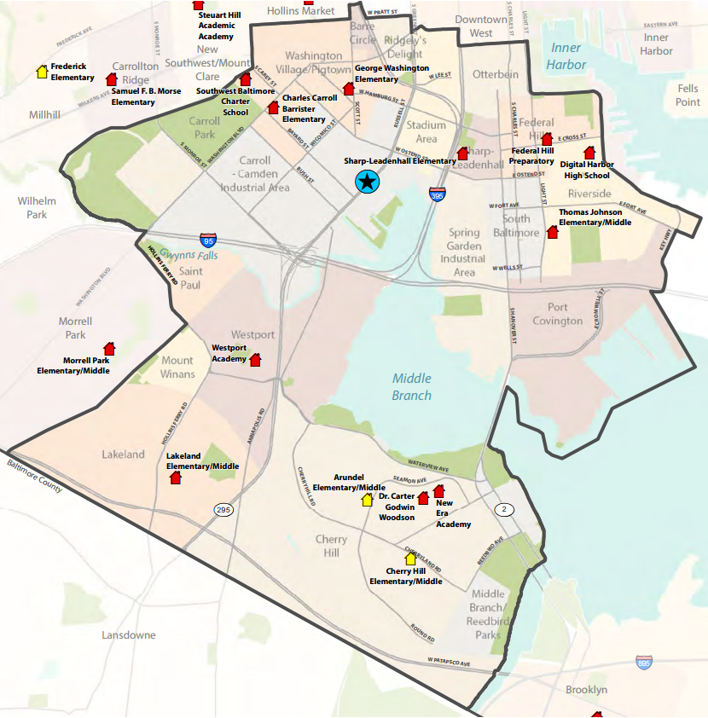

Slide 9
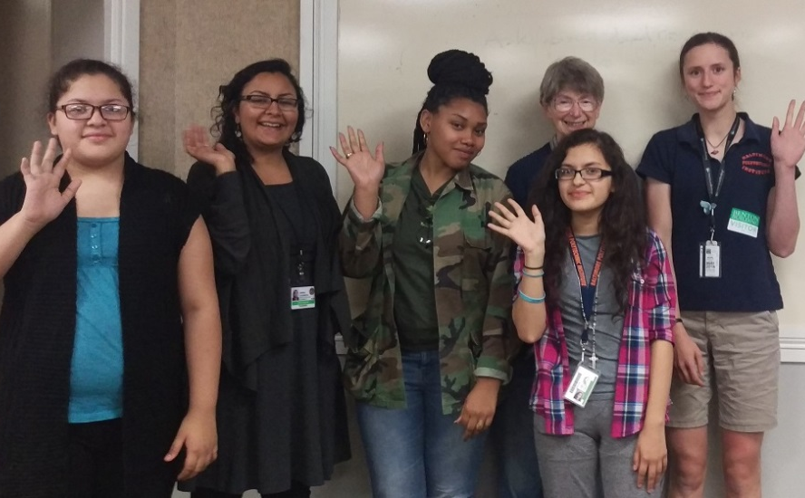
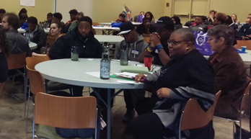
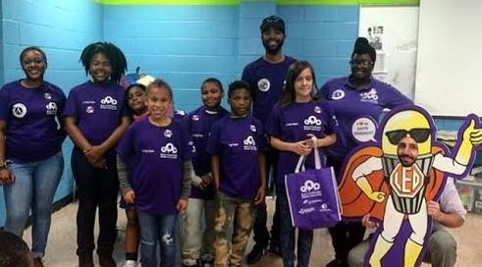
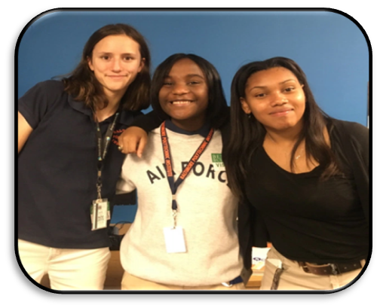
Building Student Leadership
Advocacy on lunch trays
Student Logo Design

Slide 10
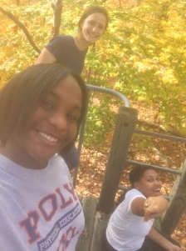
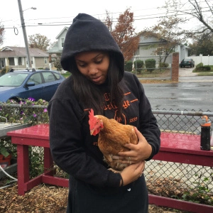
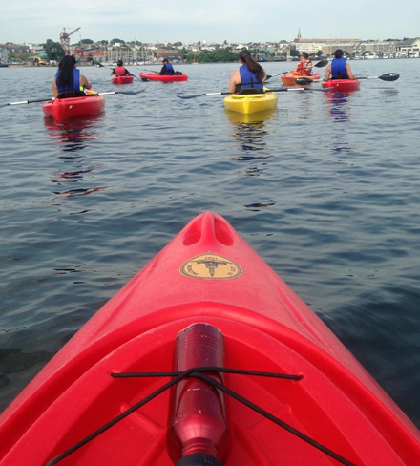
Building Student Leadership
Youth Environmental Interns

Slide 11
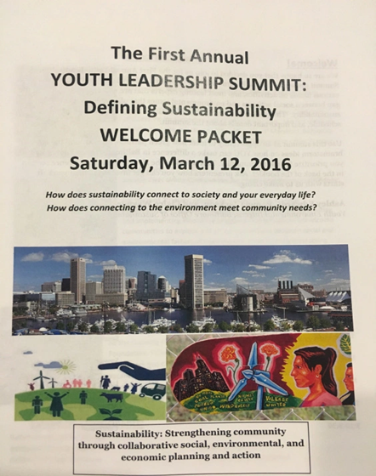
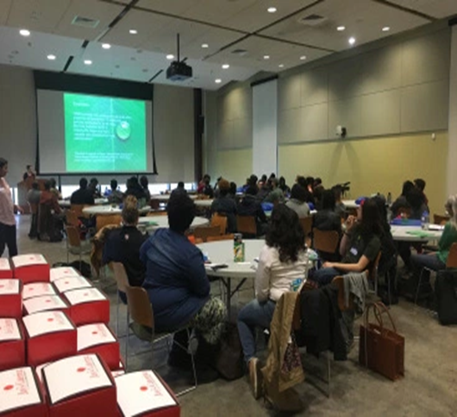
Building Student Leadership
Spring ‘16 Youth Summit

Slide 12
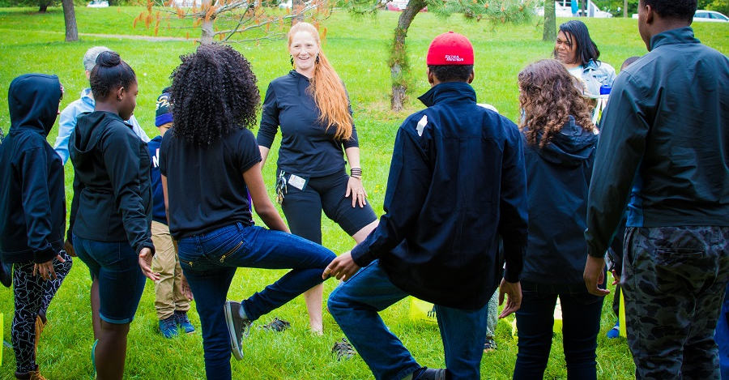
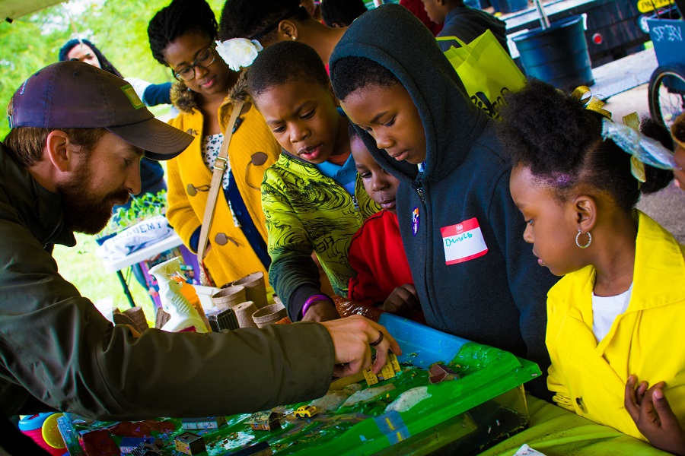
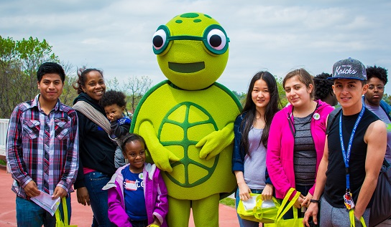
Building Student Leadership
GreenScape 2016

Slide 13
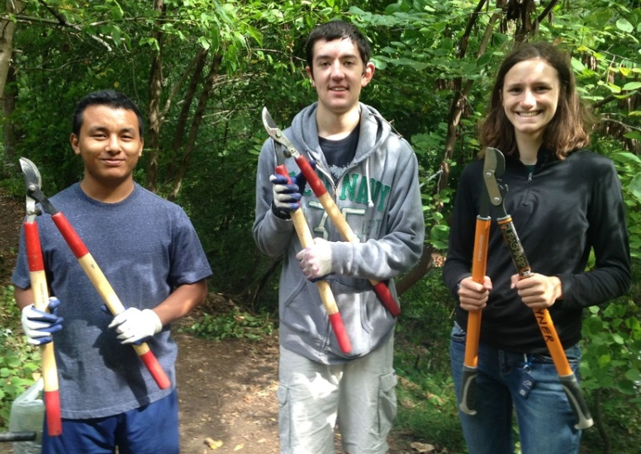
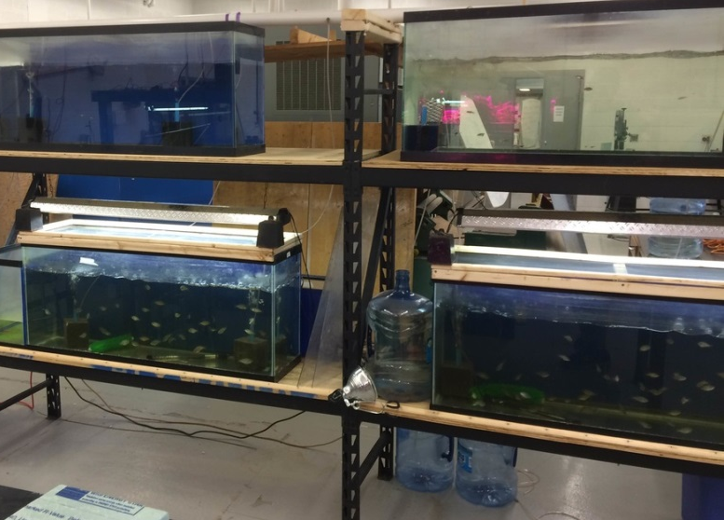
Building Student Leadership
  Snapshot: Baltimore Polytechnic Institute
  New aquaponics lab, oyster balls for the Chesapeake Bay, gardens, vine pulls and clean-ups, presentations at school-wide events, bicycle drive.
  Certified as a Green School with an application written entirely by students!
  “Green is becoming mainstream at this school! Teachers are listening to the ideas of students, and are now, especially in the past year, incorporating more and more sustainability-focused lessons in their classes.“ – Kyle L., 12th grade

Slide 14
2016-17 School Year Internship
Hiring Model Changes
  Diversify positions : Admin, Organizer, Policy
  2 Year Benefit → hired two freshman
Organizing model adjustments
  Less like a fellowship, more action-oriented
  Issue focused

Slide 15
2016-17 School Year Internship
Trainings in Preparation for the Year:
Communications Strategy Development, Jan 10, 2017
Facilitation Training—How to effectively facilitate meetings
Tuesday, January 24, 3:30-5 pm
Green Opportunity & Job Fair, 16-24 year olds Thursday, January 26, 5-8 pm
Legislative 101 Training: How legislation gets passed at the State Level, Friday, January 27, Time TBD
Legislative 101 Training: How a bill becomes a law in Baltimore City, February 15, 4-5 pm

Slide 16
2016-17 School Year Internship
Events:
Styrofoam Meeting with Legislatures in Annapolis—Bring your Foam Monsters! Field Trip Day
Wednesday, February 8, Leaving Baltimore at 8:30 am
Pre-Rally Sign Making/Gathering, February 23, 2016
Visit to the School Board, Public Comment
February 28, 6pm
Tentative: Styrofoam Rally in Baltimore
Friday, March 3, 2016, 4pm
Environmental Youth Leadership Retreat
Date: March 17, 10-3pm
Location: TBD
Celebrations
City: GreenScape – Annual Youth-led Environmental Celebration
Date: Saturday, May 13, Time TBD
State-Wide: MAEOE Green Schools Youth Summit
Date: Thursday, May 18, all day

Slide 17
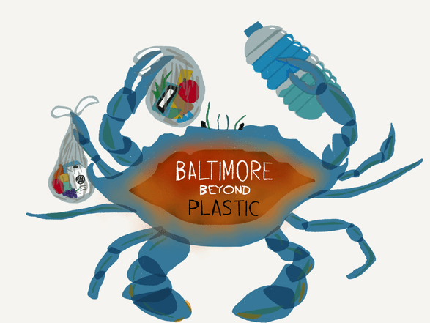

Slide 18
Goals
Reduce plastic pollution and trash in general in Baltimore
Do it while strengthening and empowering the youth voice

Slide 19
Techniques
Legislation
Expanded polystyrene (Styrofoam) ban
Bag ban/tax
(2) Community Advocacy
School visits
Youth trainings
Educational campaigns
Rally

Slide 20
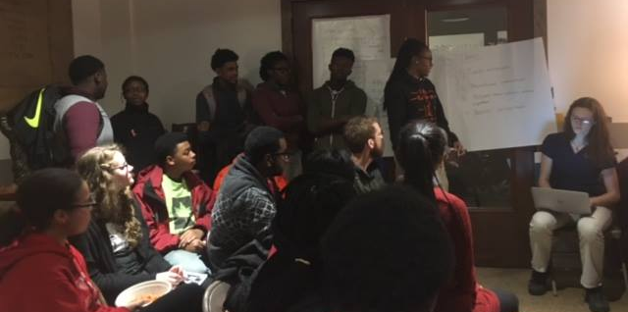
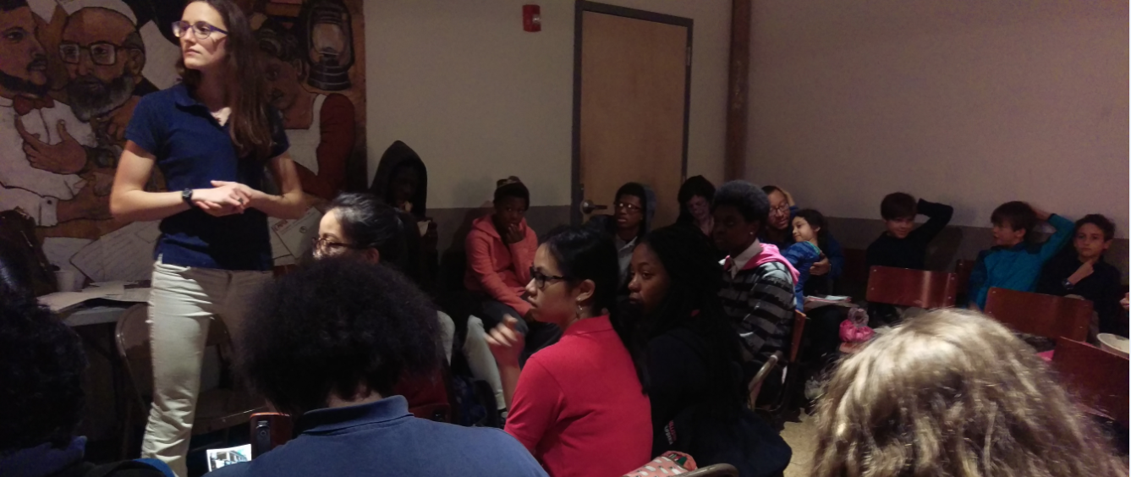

Slide 21
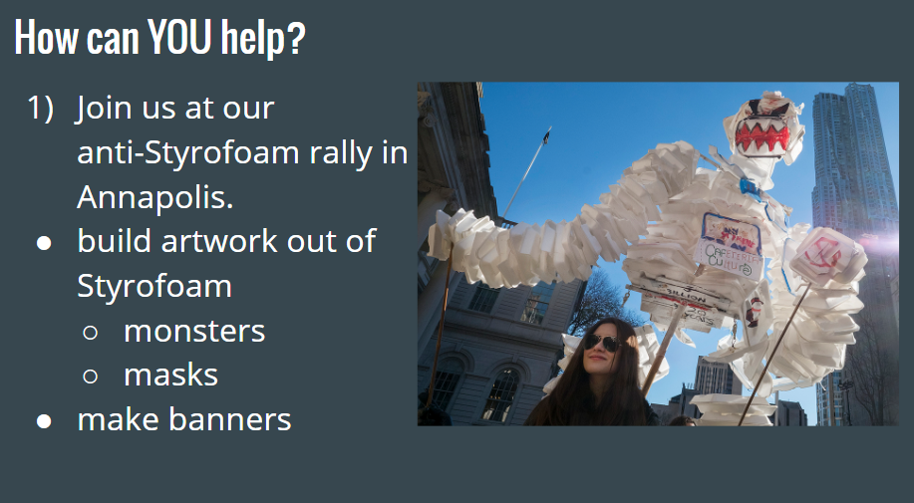

Slide 22
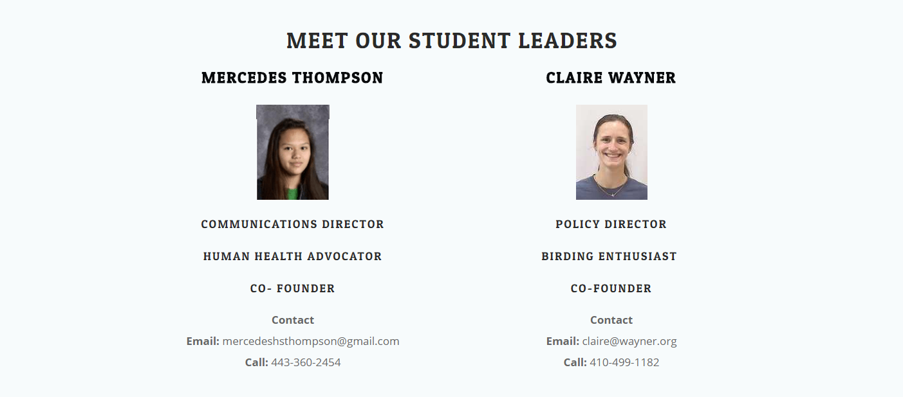

Slide 23
How to Help
Check out our website:
www.bmorebeyondplastic.org.
Sign our Styrofoam petition.
Change your lifestyle.
Follow us on Facebook, Twitter, and Instagram.
Come to our events, and spread the word!

Slide 24
