Slide 1
INNOVATIVE AND BENEFICIAL USE OF DREDGED MATERIAL
Baltimore City Sustainability Commission
Presented by Maryland Department of Transportation
Port Administration
November 29, 2016
Notes:
Thanks for the invite to speak to you today. I am here to talk about something that has long been considered a waste - but which we at the Port Administration want to turn into an economically and environmentally valuable resource – dredged material
I want to acknowledge Andy Cook from your office who recently joined our advisory committee to help us sort out what can and cannot be done with harbor dredged material

Slide 2
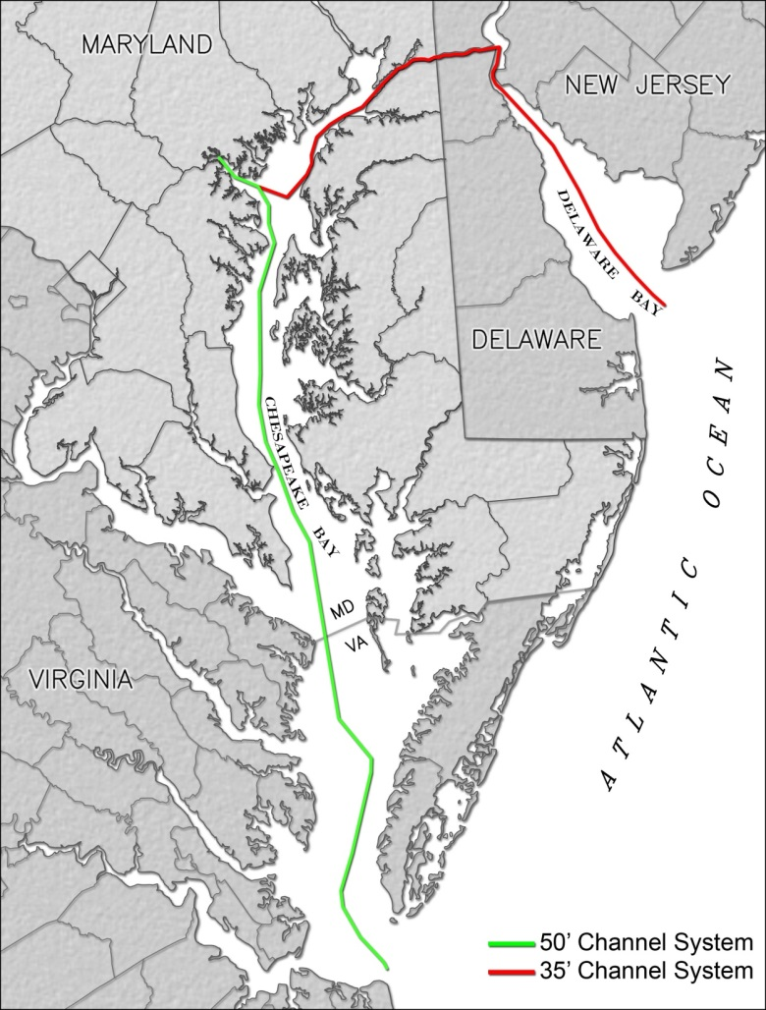
Dredging and Dredged Material Management
134 miles of dredged channels
Average annual dredging demand:
  5.2 million cubic yards (mcy) entire system;
  1.5 mcy Harbor
Dredged material management:
  Upland dredged material containment facilities (DMCFs),
  Environmental restoration (Poplar Island),
  Open water in VA
Notes:
We at the port and our partners at the Corps of Engineers need to remove, on average, 1.5 mcy of sediment from harbor shipping channels each year, to maintain the depths needed for marine commerce
Dredging quantities are planning numbers

Slide 3
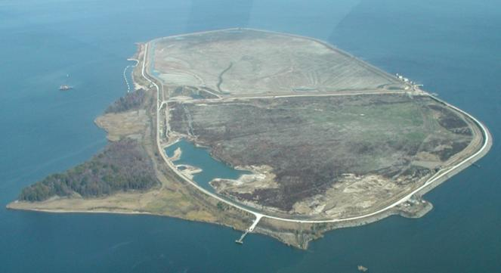
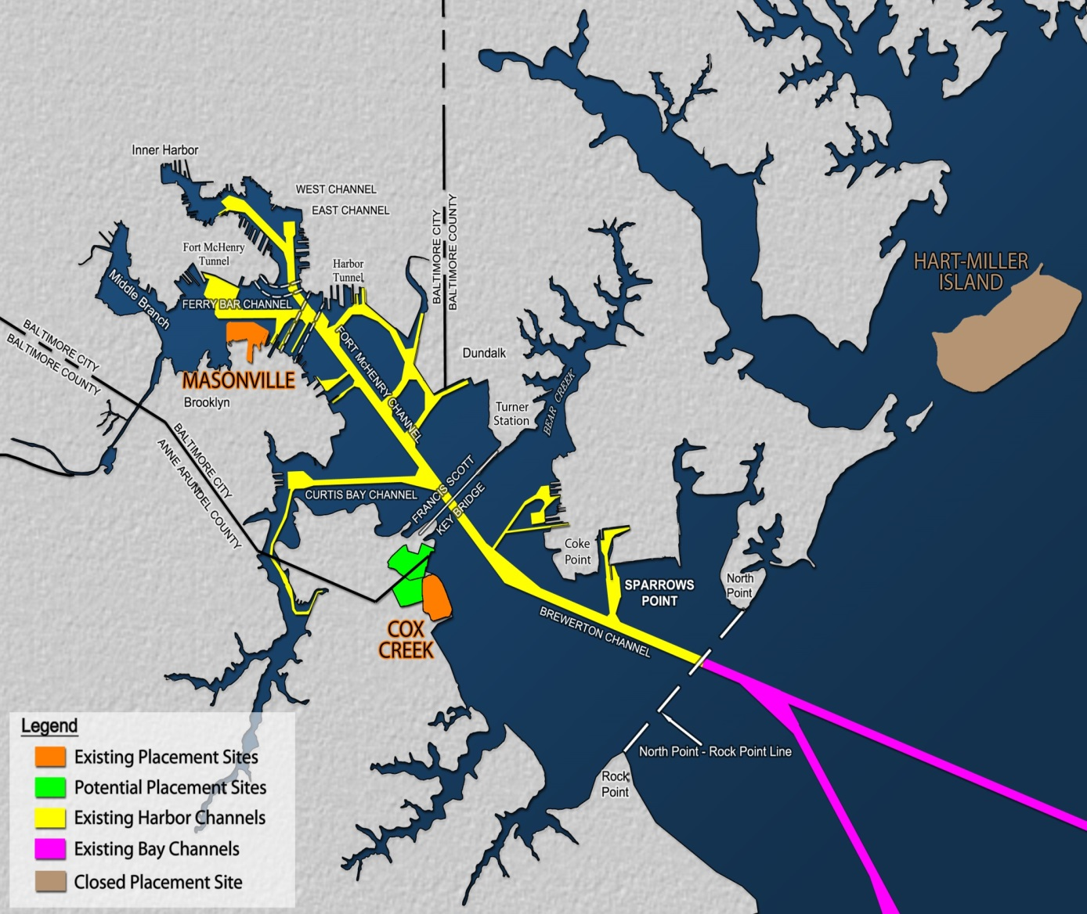
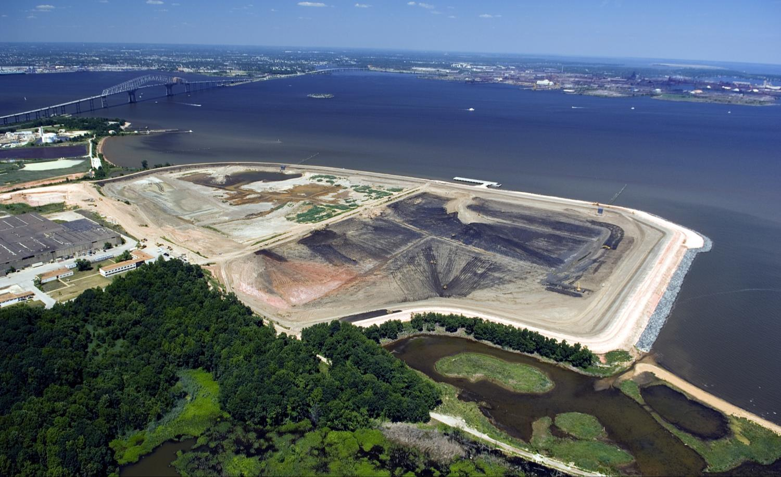
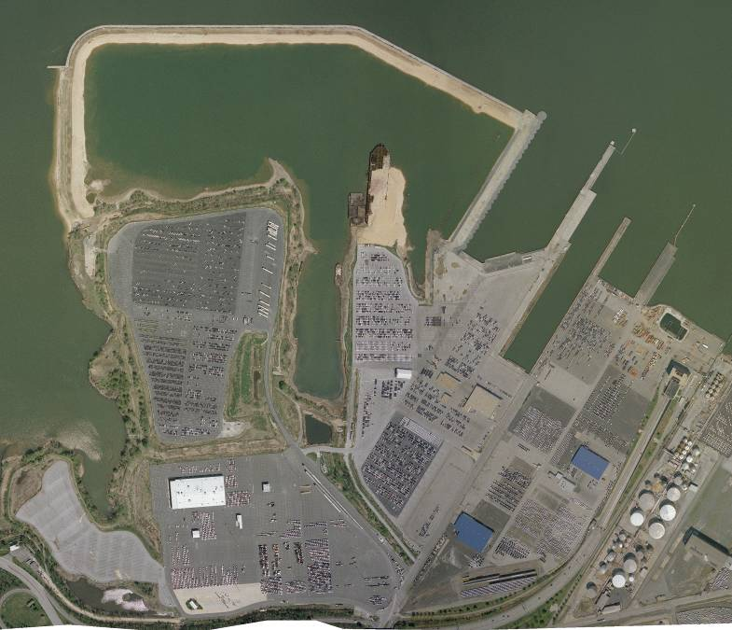
Harbor Placement
Options
Hart Miller Island
CLOSED
Cox Creek DMCF
Masonville
DMCF
Notes:
In 1975 the state legislature declared that harbor sediment could be harmful to the Chesapeake Bay if redeposited in the Bay in an unconfined manner – known as open water placement, which was the management solution at the time. Following that legislative declaration, the Port and the Corps of Engineers rebuilt the eroding islands of Hart and Miller islands off of Baltimore County in the Patapsco as the dredged material containment facility, for both Harbor and Bay channel material, which we used for 25 years. We now place material in Cox Creek and Masonville. But we are running out of space - - and the need to dredge is ongoing

Slide 4
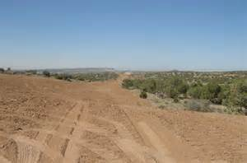
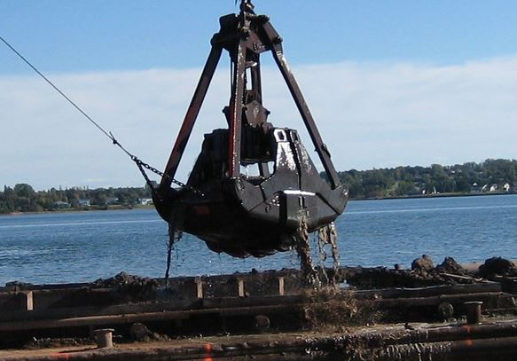
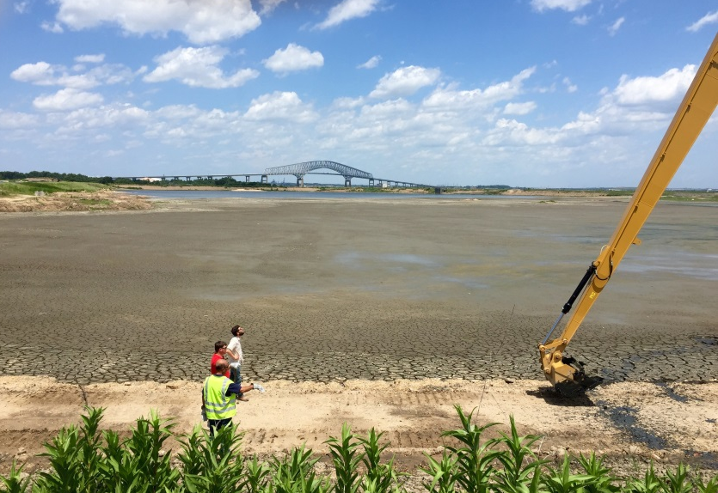
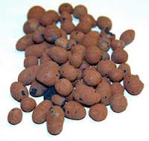
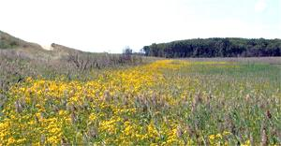
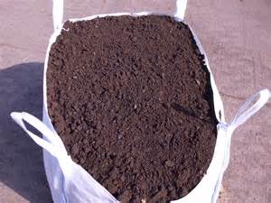
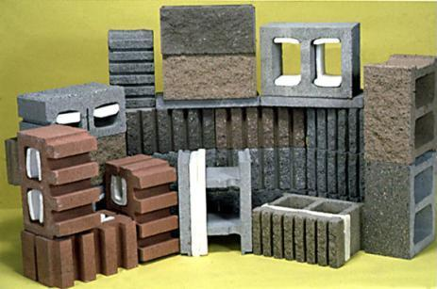
Innovative Reuse & Beneficial Use
Notes:
We have learned that most of the sediment we dredge from shipping channels is clean enough to recycle and reuse for purposes such as capping of brownfields and landfills, and for construction purposes such as road building, engineered fill and lightweight aggregate. We know this can be done because we have conducted extensive studies of the chemistry and the geotechnical qualities of the sediment and compared those results with MDE’s standards and with the needs expressed by construction engineers

Slide 5
Technical Screening Criteria and Guidance Document
Goal:
  Provide certainty and predictability
  Ensure environmental and public health protections
Drafting currently underway
Close coordination with regulatory programs at MDE, MDA, SHA, toxicologists, chemists, sediment experts
Importance of Public Input
Iterative process with multiple opportunities for public and agency review and feedback
  December / January
MDE Approval currently estimated for Spring 2017
Notes:
At the Port Administration we are partnering with MDE to develop sediment quality criteria and guidance to make the permitting process more straightforward both for those who want to use dredged material and for MDE. We think this will encourage the private sector to come up with creative ways to use dredged material
We are also partnering with the State Highway Administration – most likley SHA uses are as engineered fill or a manufactured topsoil or soil product. Working with them on the Recylced Materials specification as well as updated their Topsoil specifications.

Slide 6
Outreach & Education Materials
Goal:
  Address the long-held negative public perception of Harbor channel material in order to build public awareness and support for innovative reuse products and beneficial use projects
Building upon feedback from stakeholders:
  Engage with a marketing firm and develop catchy, interesting and informative materials:
    Slogan
    Infographic
    Video
    Social Media strategy
Notes:
One of our biggest tasks right now is to engage the public and demonstrate that sediments dredged from harbor shipping channels can be safely reused. This is a daunting task because the public perception continues to be that harbor sediments are toxic, hazardous or overly contaminated. We know that this was an industrial harbor, home to chemical companies, steelmaking, shipbuilding and so forth dating back to the time when there was little restriction on what could be discharged into our waters. We know that legacy contaminants can still be found in the UNDREDGED portions of the harbor. But restrictive discharge limits in place since the Clean Water Act was passed in 1972 have greatly reduced pollutants coming into the harbor, and because our channels are routinely dredged, legacy contaminants have long since been removed from the channels. So we are reaching out via various means to show the public what can be done with what we used to think of as a waste.
Next, one of the workgroup’s key findings was that the historic, strongly-held negative public perception of Harbor sediment removed from the shipping channels has the potential to continue to stifle acceptance of innovative reuse products and beneficial use projects.
And so, we recognized that there was work to be done – that we need to build greater public support and awareness for the safe reuse of channel dredged material and do this through more engaging marketing-type materials:
Things like a video;
A catchy slogan;
an infographic;
And interesting social media posts.
All of these alternative and engaging mediums can help us tell the story of why we need to succeed in developing an innovative reuse program.
But to do so, we need to begin at the starting point: that the Port of Baltimore is an important economic engine for the state and region; the role that dredging plays in keeping the Port competitive; and how all of that dirt can safely be recycled into other products and materials that have economic value.
Along the way, we have been out there talking with our committee members, stakeholders, the private sector, partners and citizens and hearing from you, learning and incorporating your suggestions and recommendations and refining these materials accordingly.

Slide 7
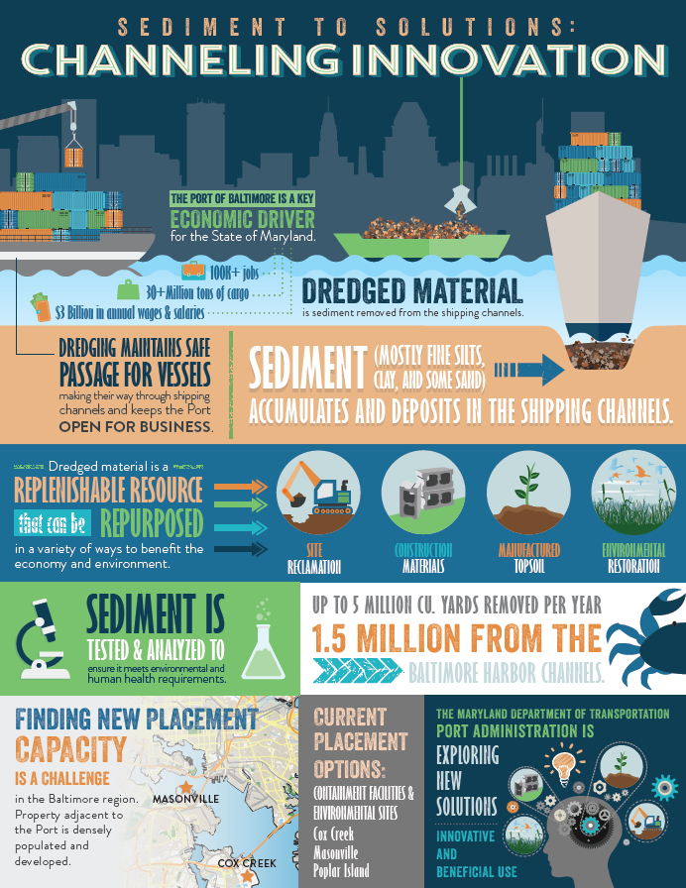
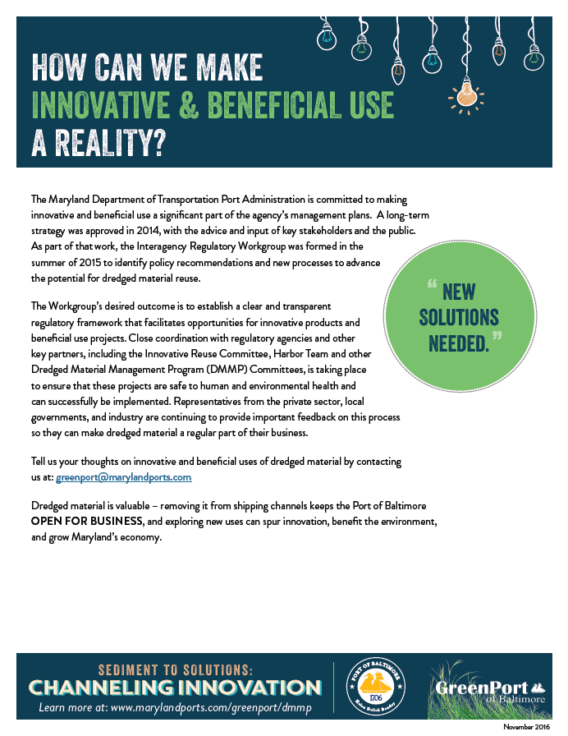
Sediment to Solutions:
Channeling Innovation
Notes:
We have fact sheets, a new infographic, a video, and we are beginning to use social media to engage Baltimoreans in the idea that we can reuse this valuable, under-appreciated resource!! Good for business, good for the budget, and good for the environment!

Slide 8

Sediment to Solutions:
Channeling Innovation
QUESTIONS?
Notes:
We hope you will consider including the recycling of dredged material as a viable waste reduction strategy in the City’s revised sustainability plan
Sediment to Solutions: Channeling Innovation – distribute infographic
Thank you so much for your time – we really look forward to continued opportunities to work together and support one another’s goals.

